Slide 1

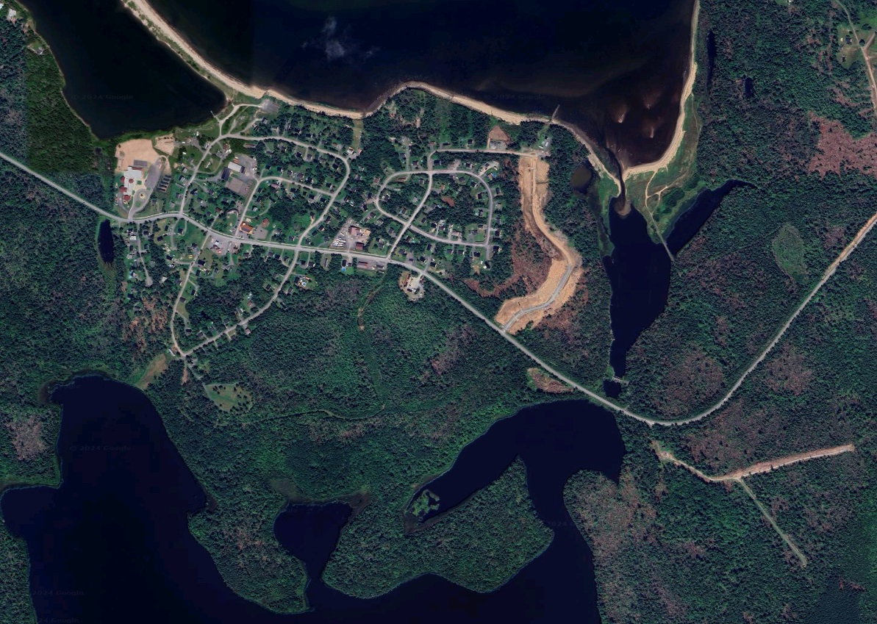
Pictou Landing First Nation
Land Use Plan 2024/2025
PLFN Pre-Planning Phase Activities
Part 3
Notes:
Thanks!

Slide 2
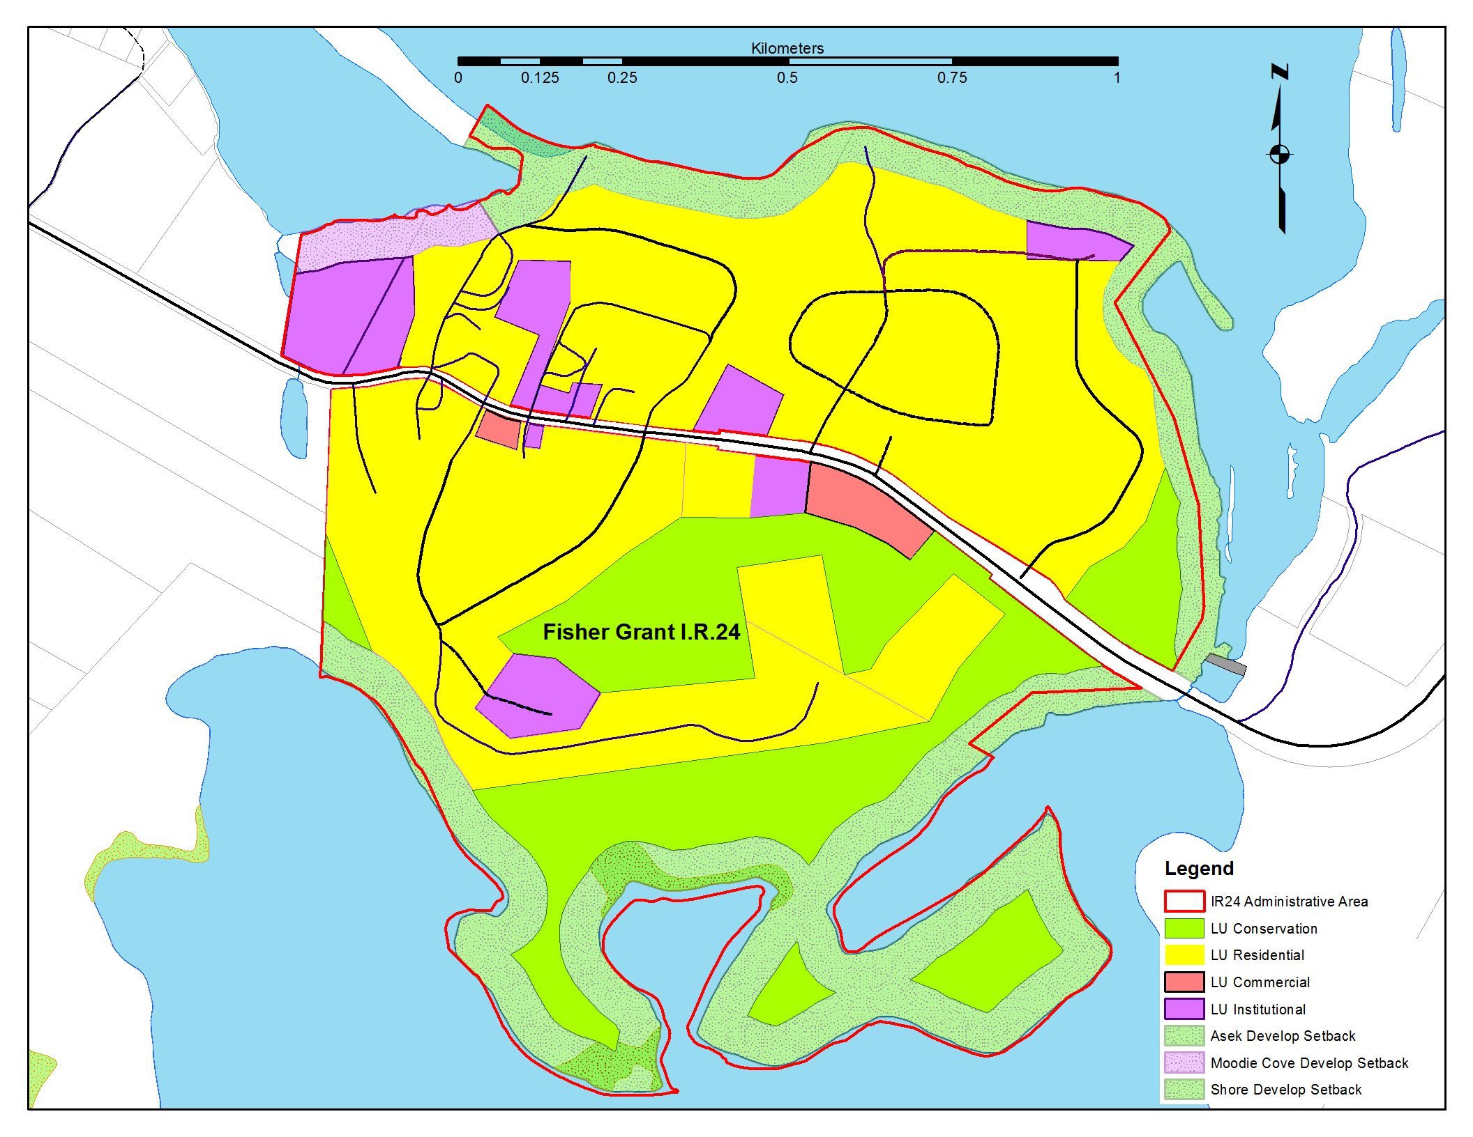
PLFN Pre-Planning Phase Activities
Future Land Use Option 1
IR 24

Slide 3
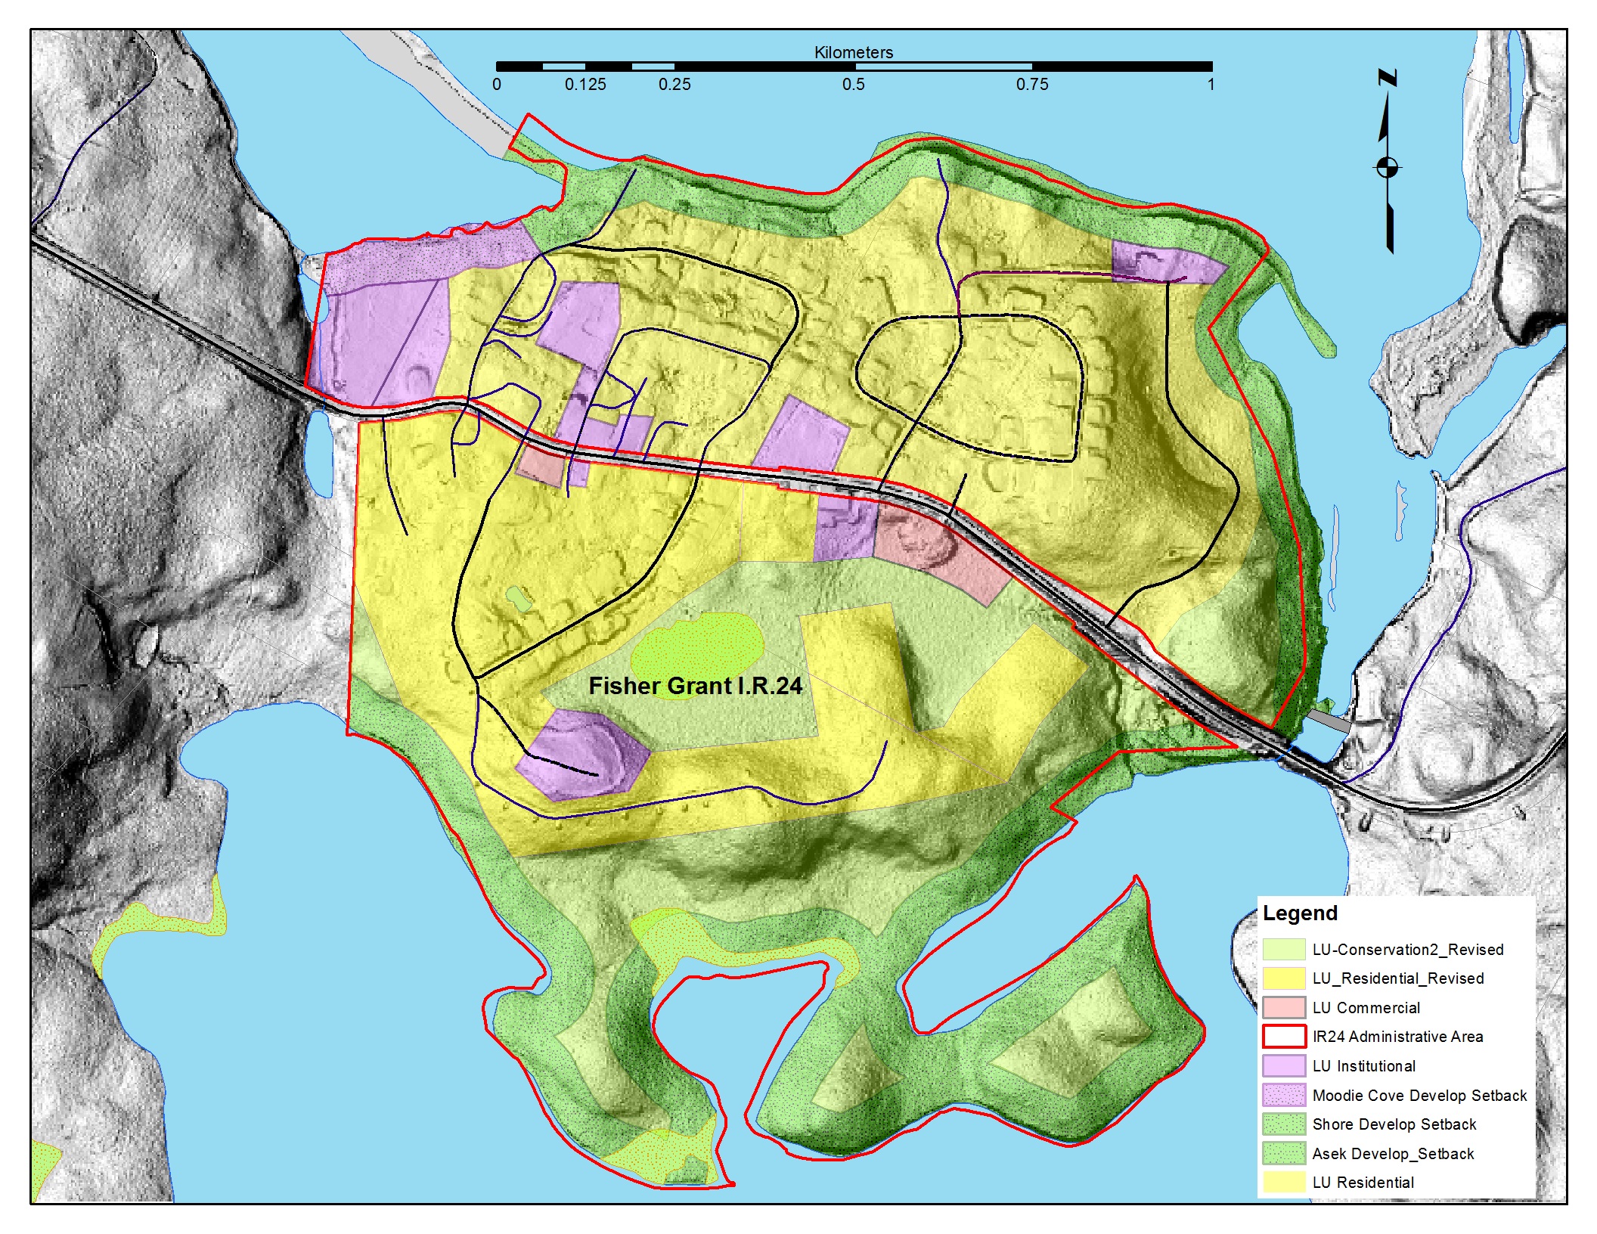
PLFN Pre-Planning Phase Activities
Future Land Use Option 1
IR 24

Slide 4
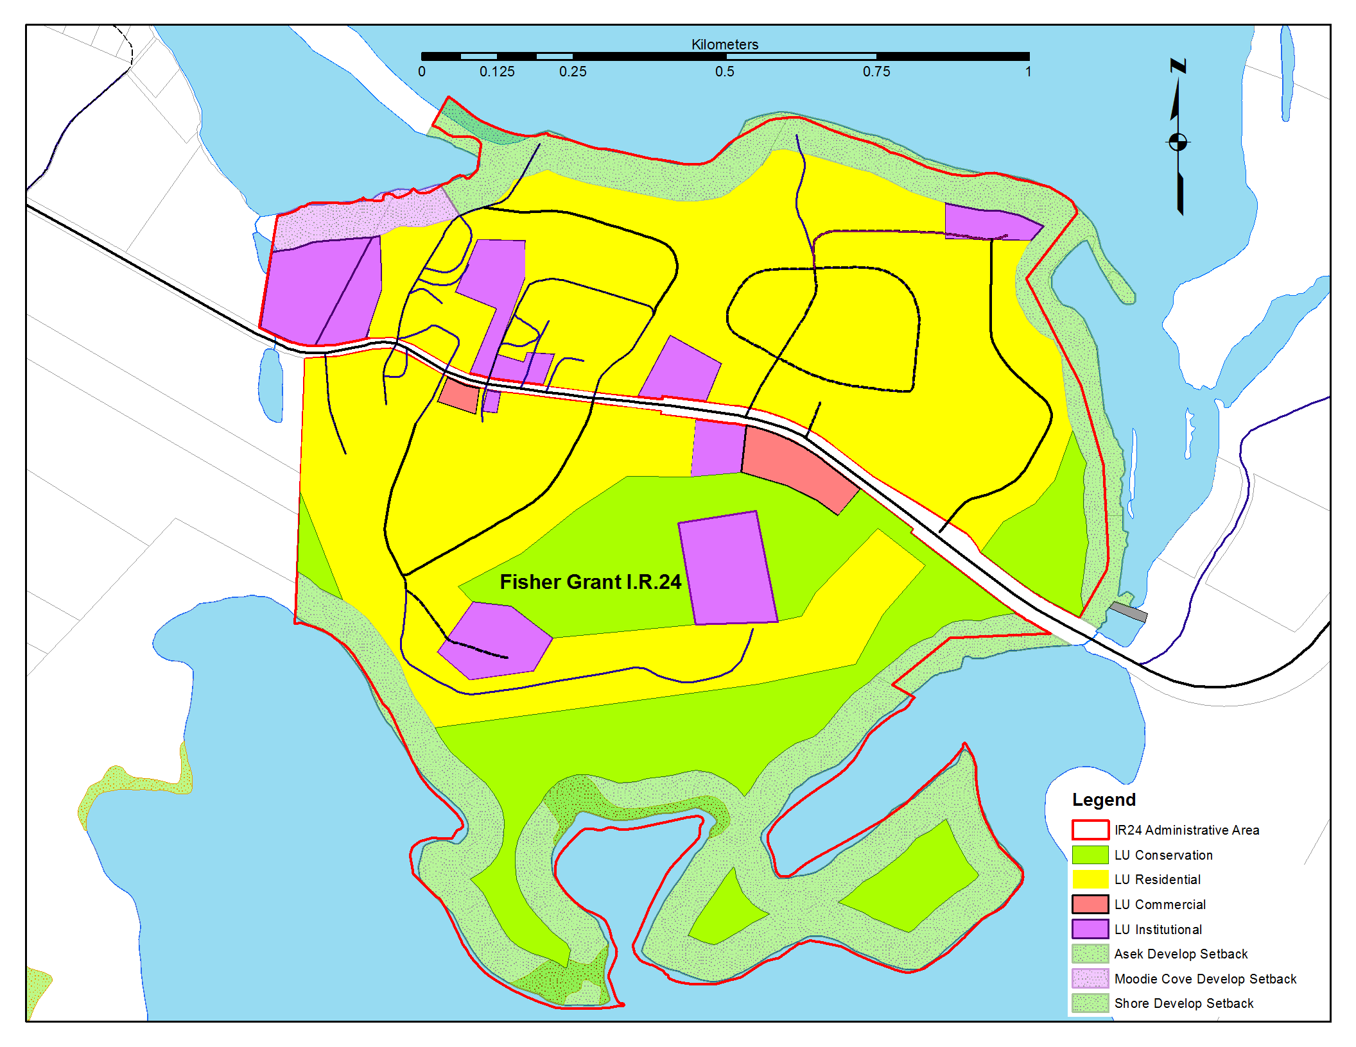
PLFN Pre-Planning Phase Activities
Future Land Use Option 2
IR 24

Slide 5

PLFN Pre-Planning Phase Activities
Future Land Use Option 2
IR 24

Slide 6
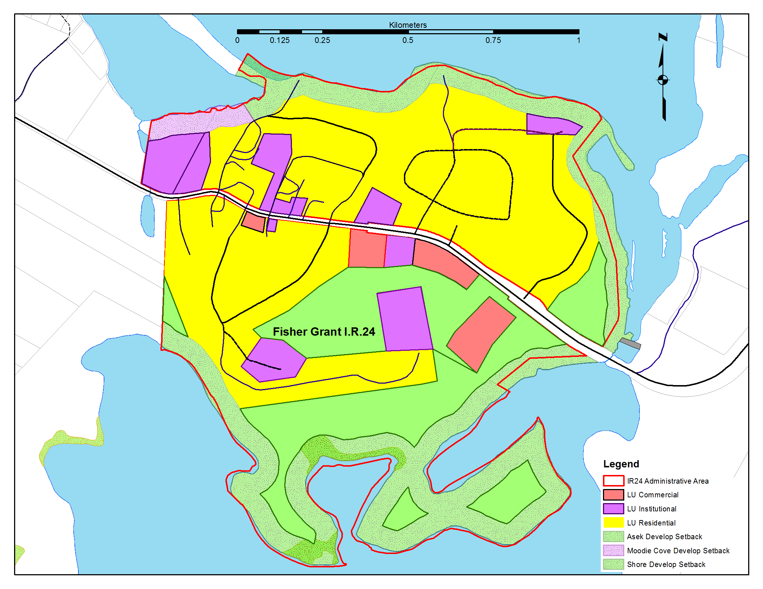
PLFN Pre-Planning Phase Activities
Future Land Use Option 3
IR 24

Slide 7
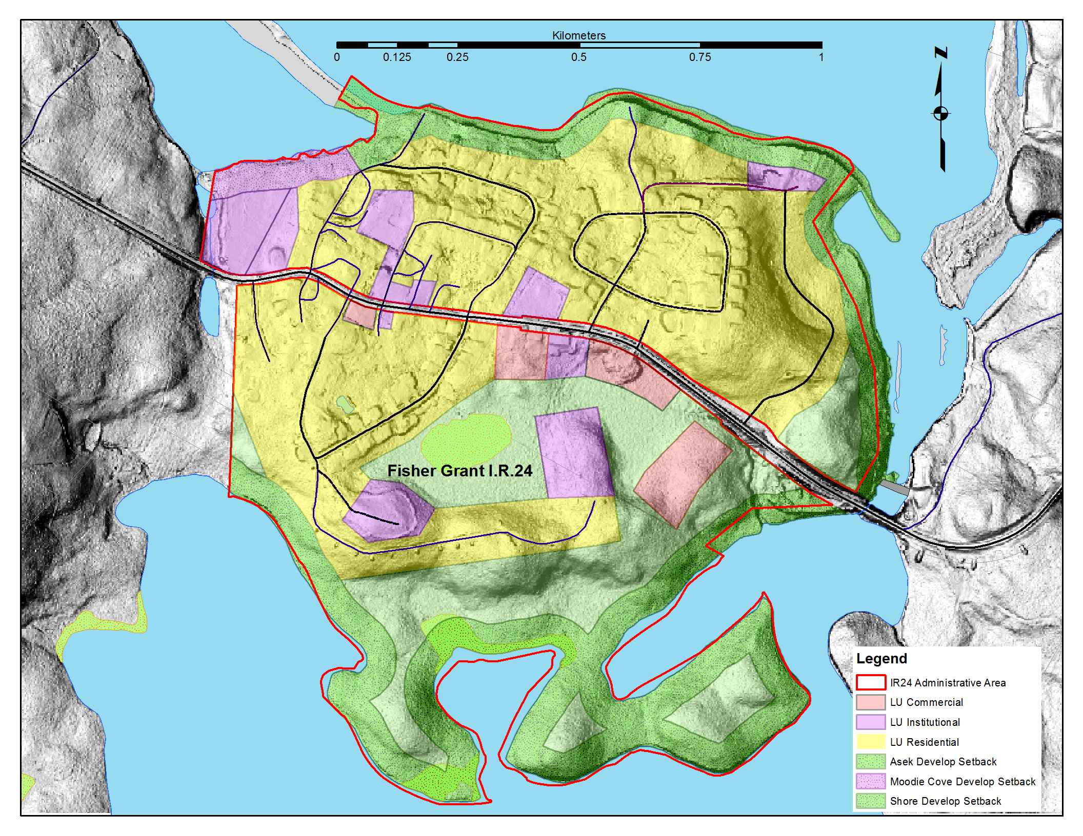
PLFN Pre-Planning Phase Activities
Future Land Use Option 3
IR 24

Slide 8
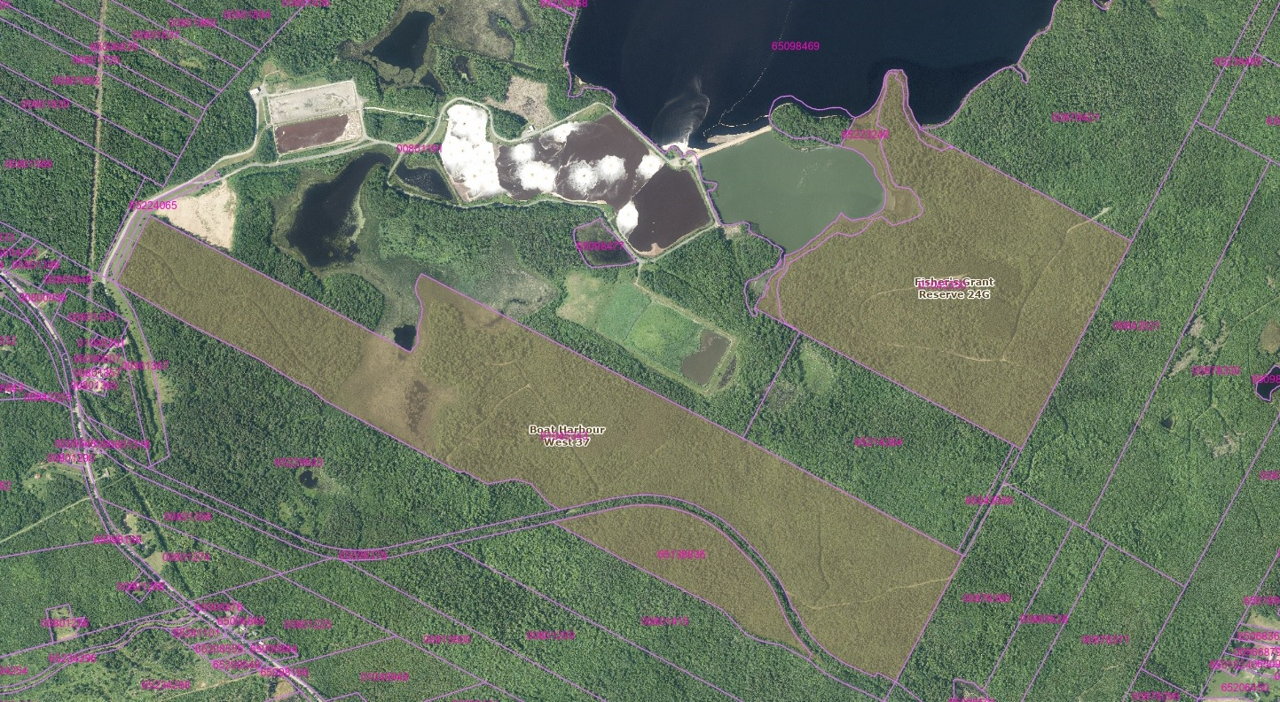
PLFN Pre-Planning Phase Activities
IR 37 and IR 24G

Slide 9
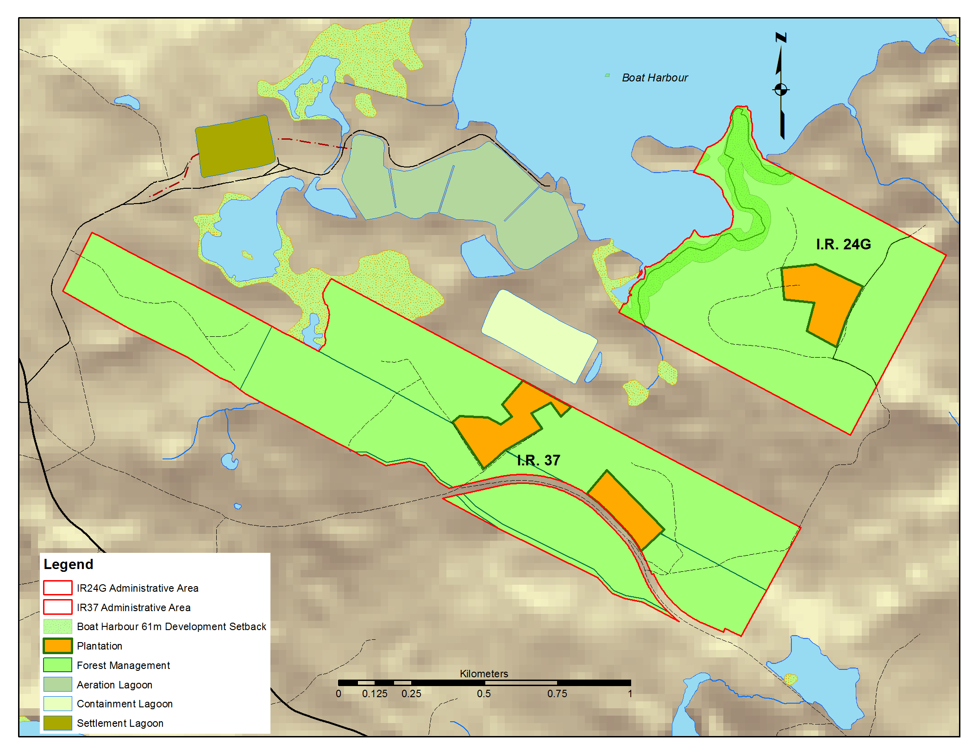
PLFN Pre-Planning Phase Activities
Future Land Use
IR 37 and IR 24G

Slide 10
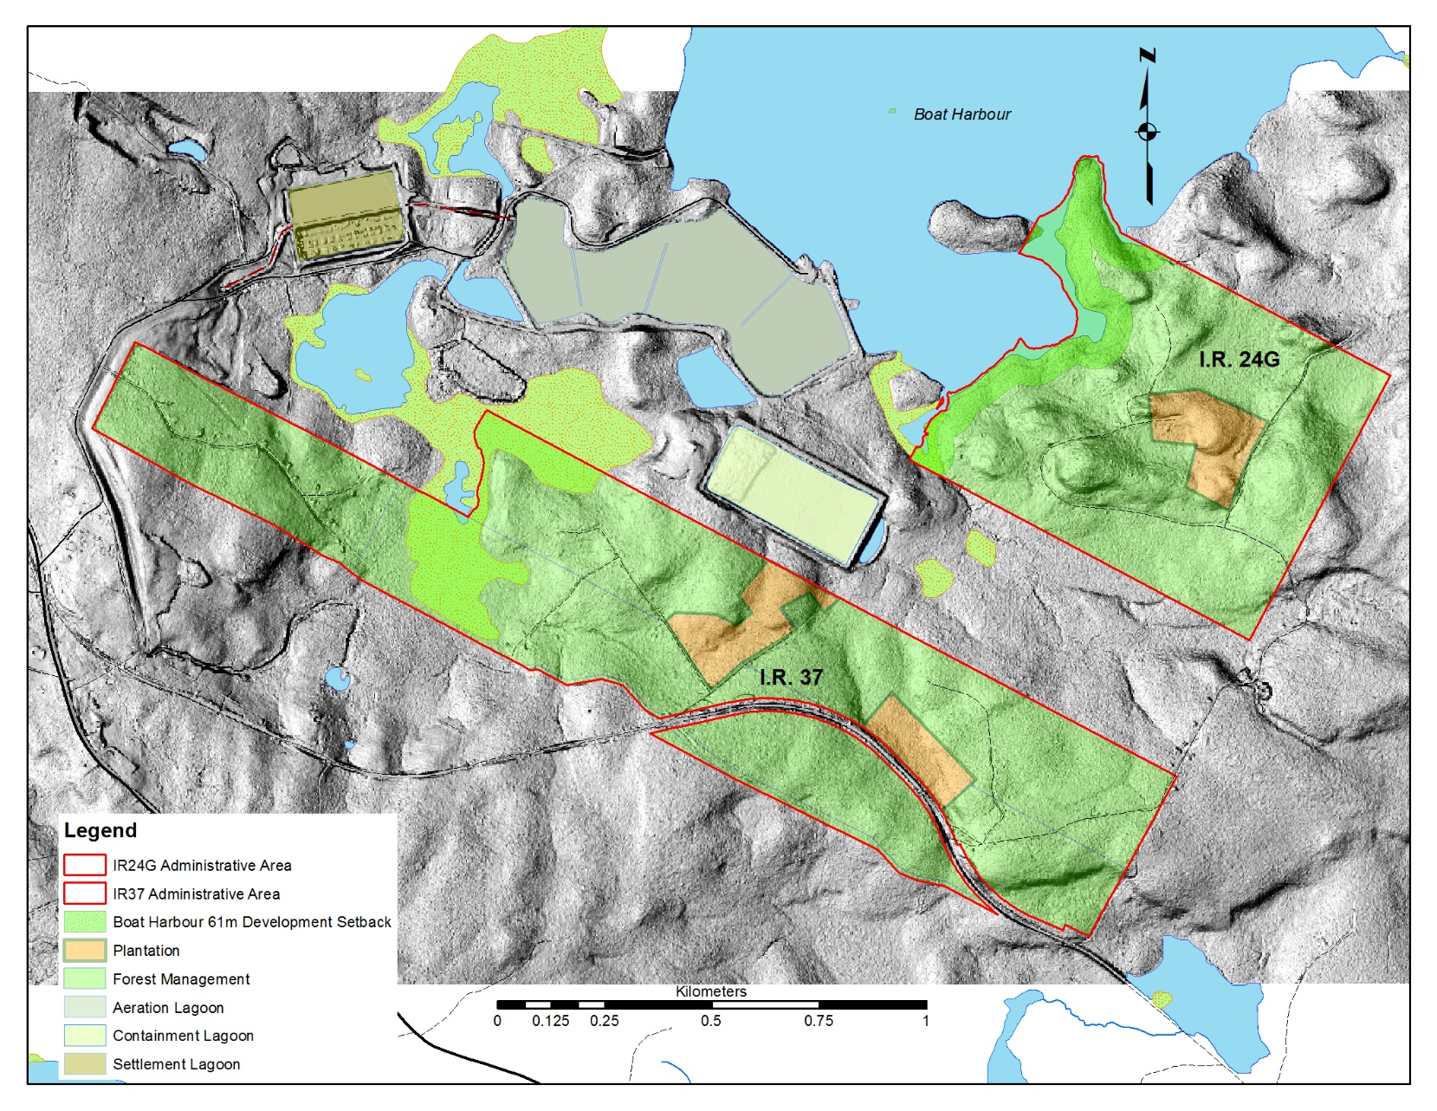
PLFN Pre-Planning Phase Activities
Future Land Use
IR 37 and IR 24G

Slide 11
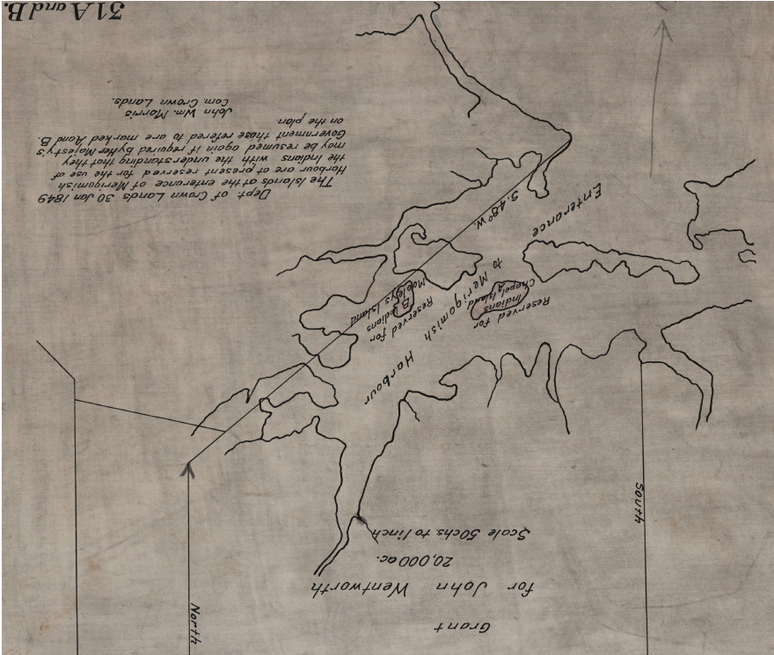
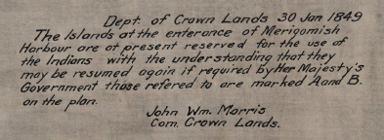
PLFN Pre-Planning Phase Activities
Research
Merigomish Islands
Merigomish Harbour I.R.31A and I.R.31B
1849

Slide 12
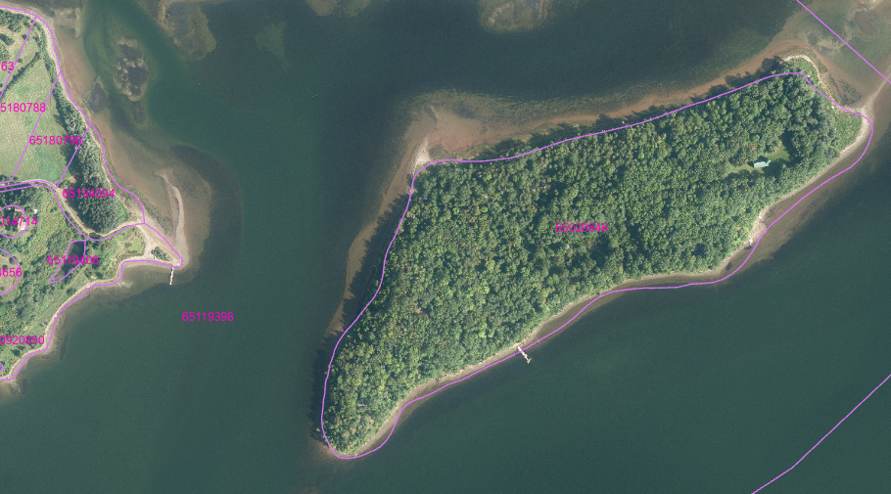
PLFN Pre-Planning Phase Activities
Research
Merigomish Islands
Maligomish (Chapel )(Indian) Island

Slide 13
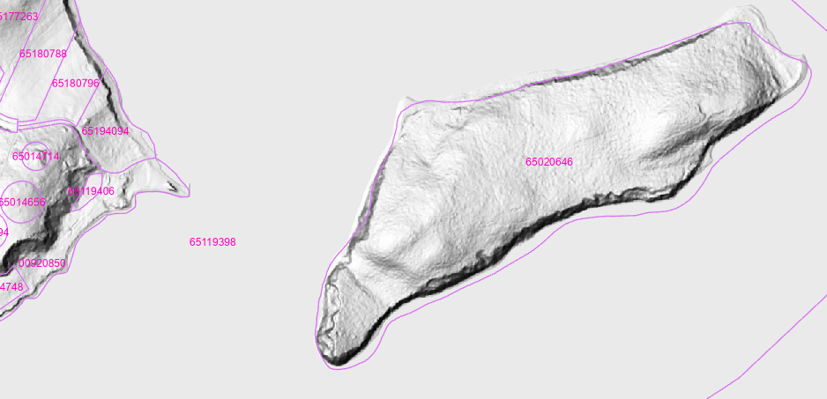
PLFN Pre-Planning Phase Activities
Research
Merigomish Islands
Maligomish (Chapel /Indian) Island

Slide 14
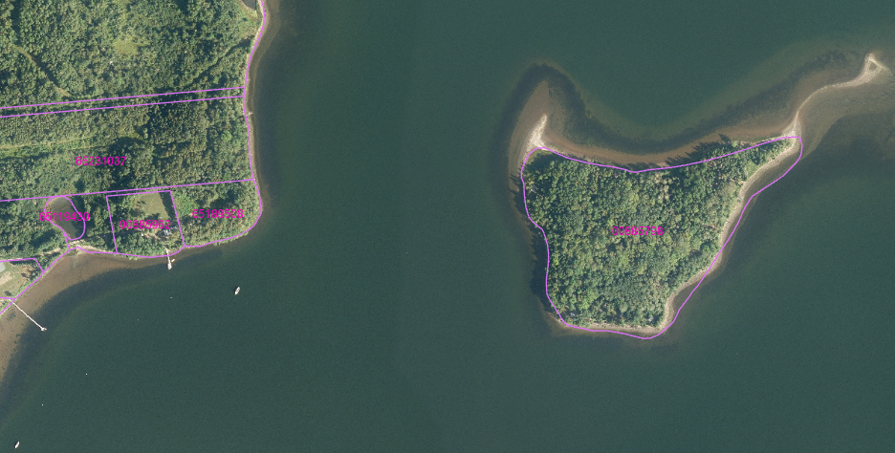
PLFN Pre-Planning Phase Activities
Research
Merigomish
Muless (Mooleys) Island

Slide 15
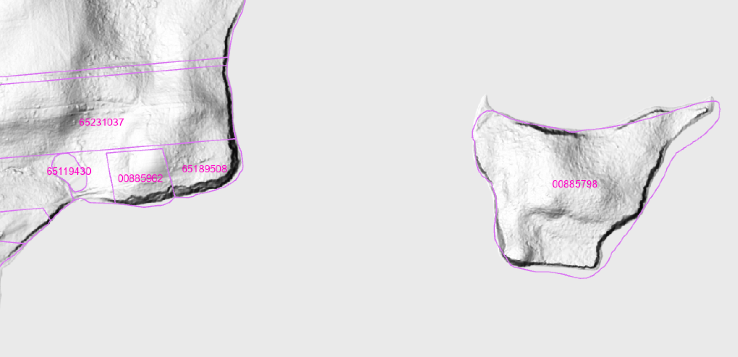
PLFN Pre-Planning Phase Activities
Research
Merigomish Islands
Muless (Mooleys) Island

Slide 16
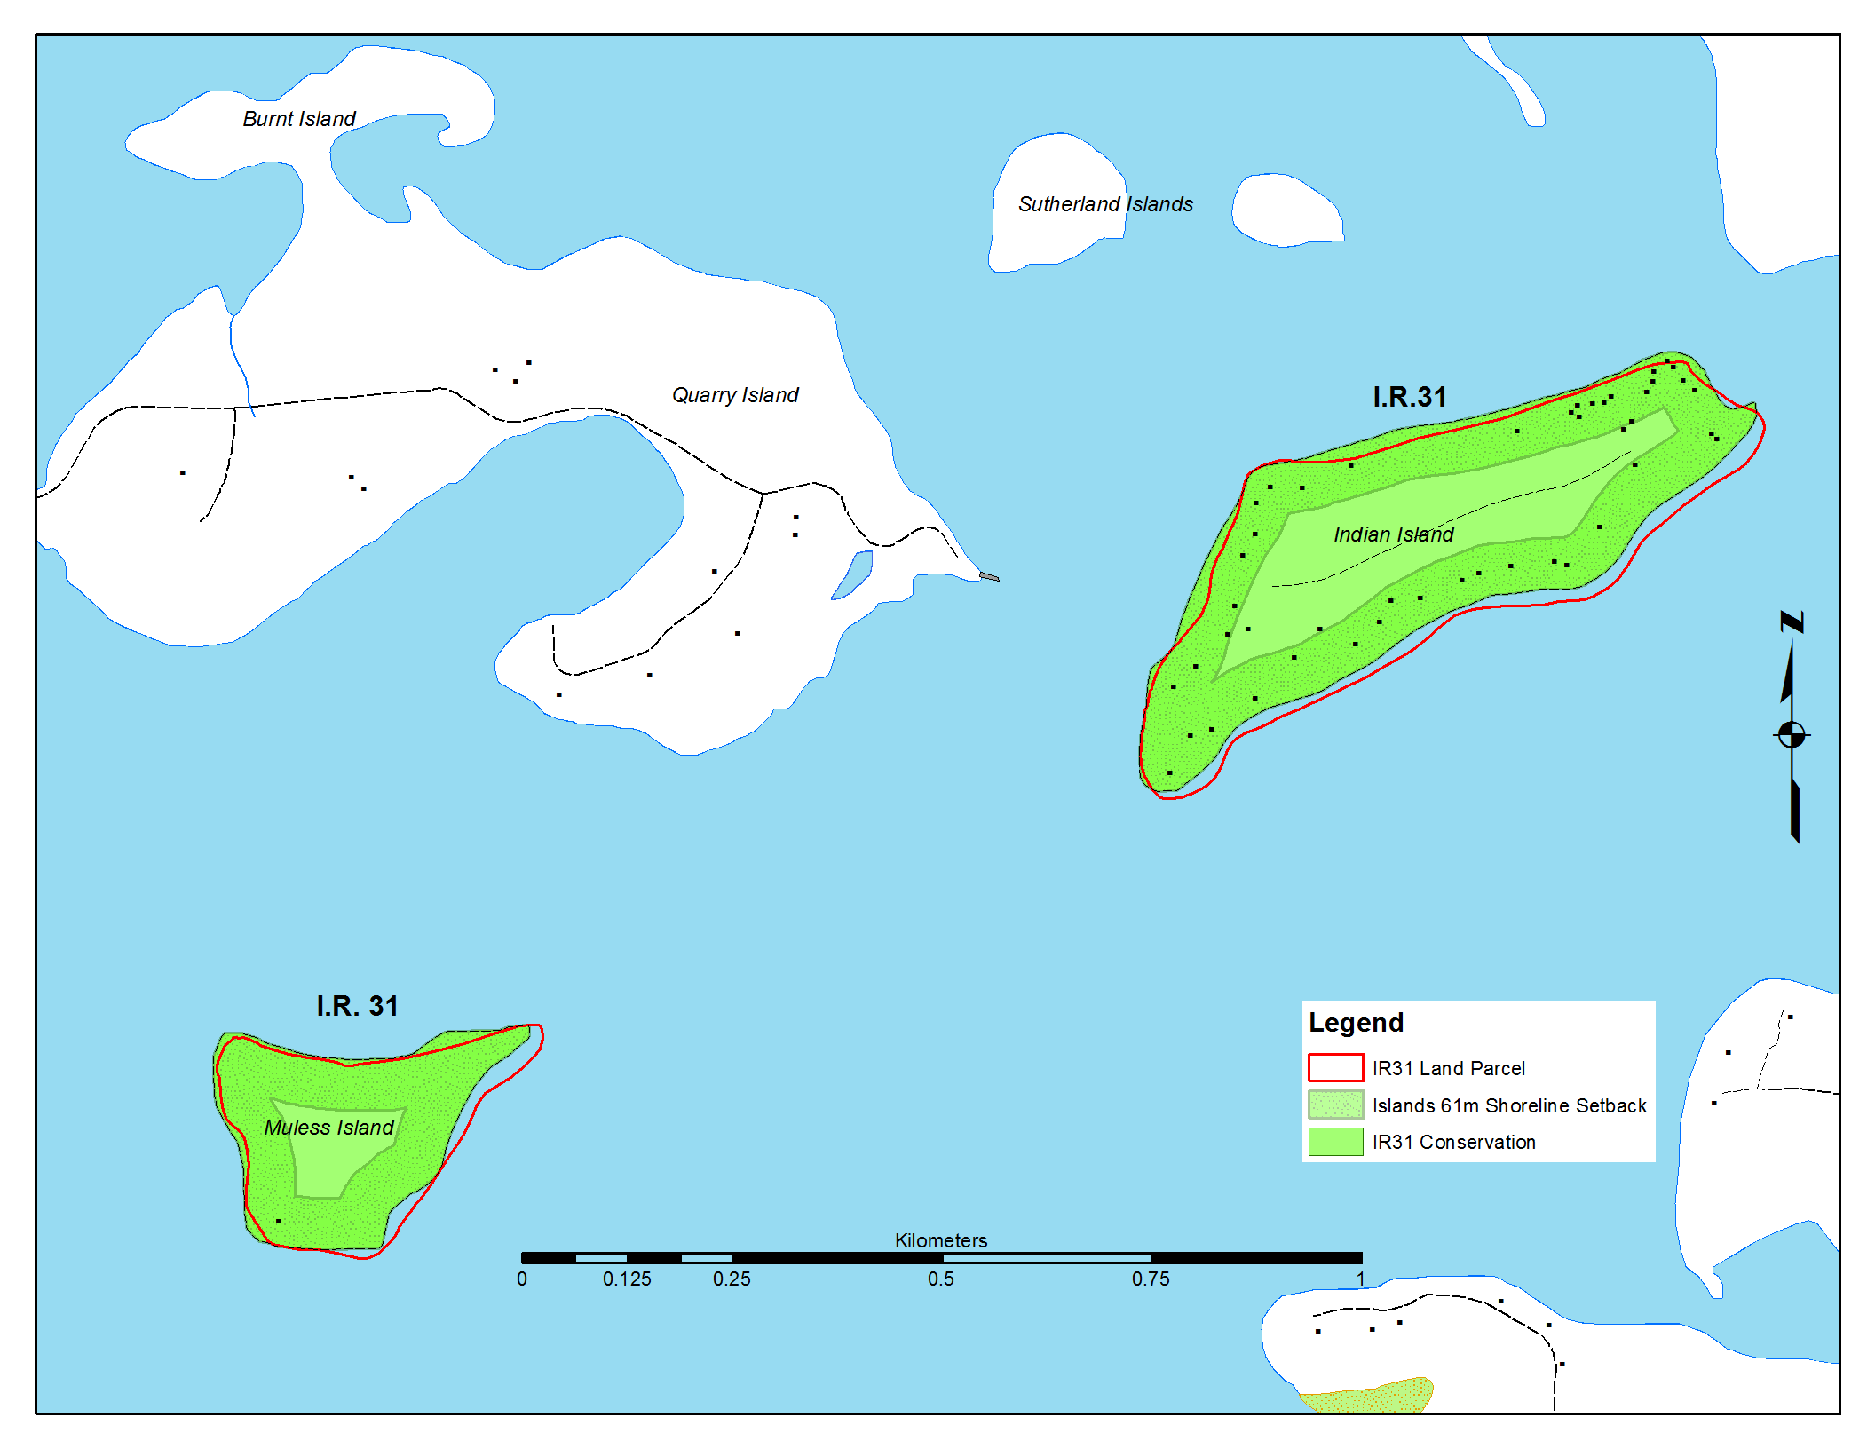
PLFN Pre-Planning Phase Activities
Proposed Future Land Use
Merigomish Islands

Slide 17
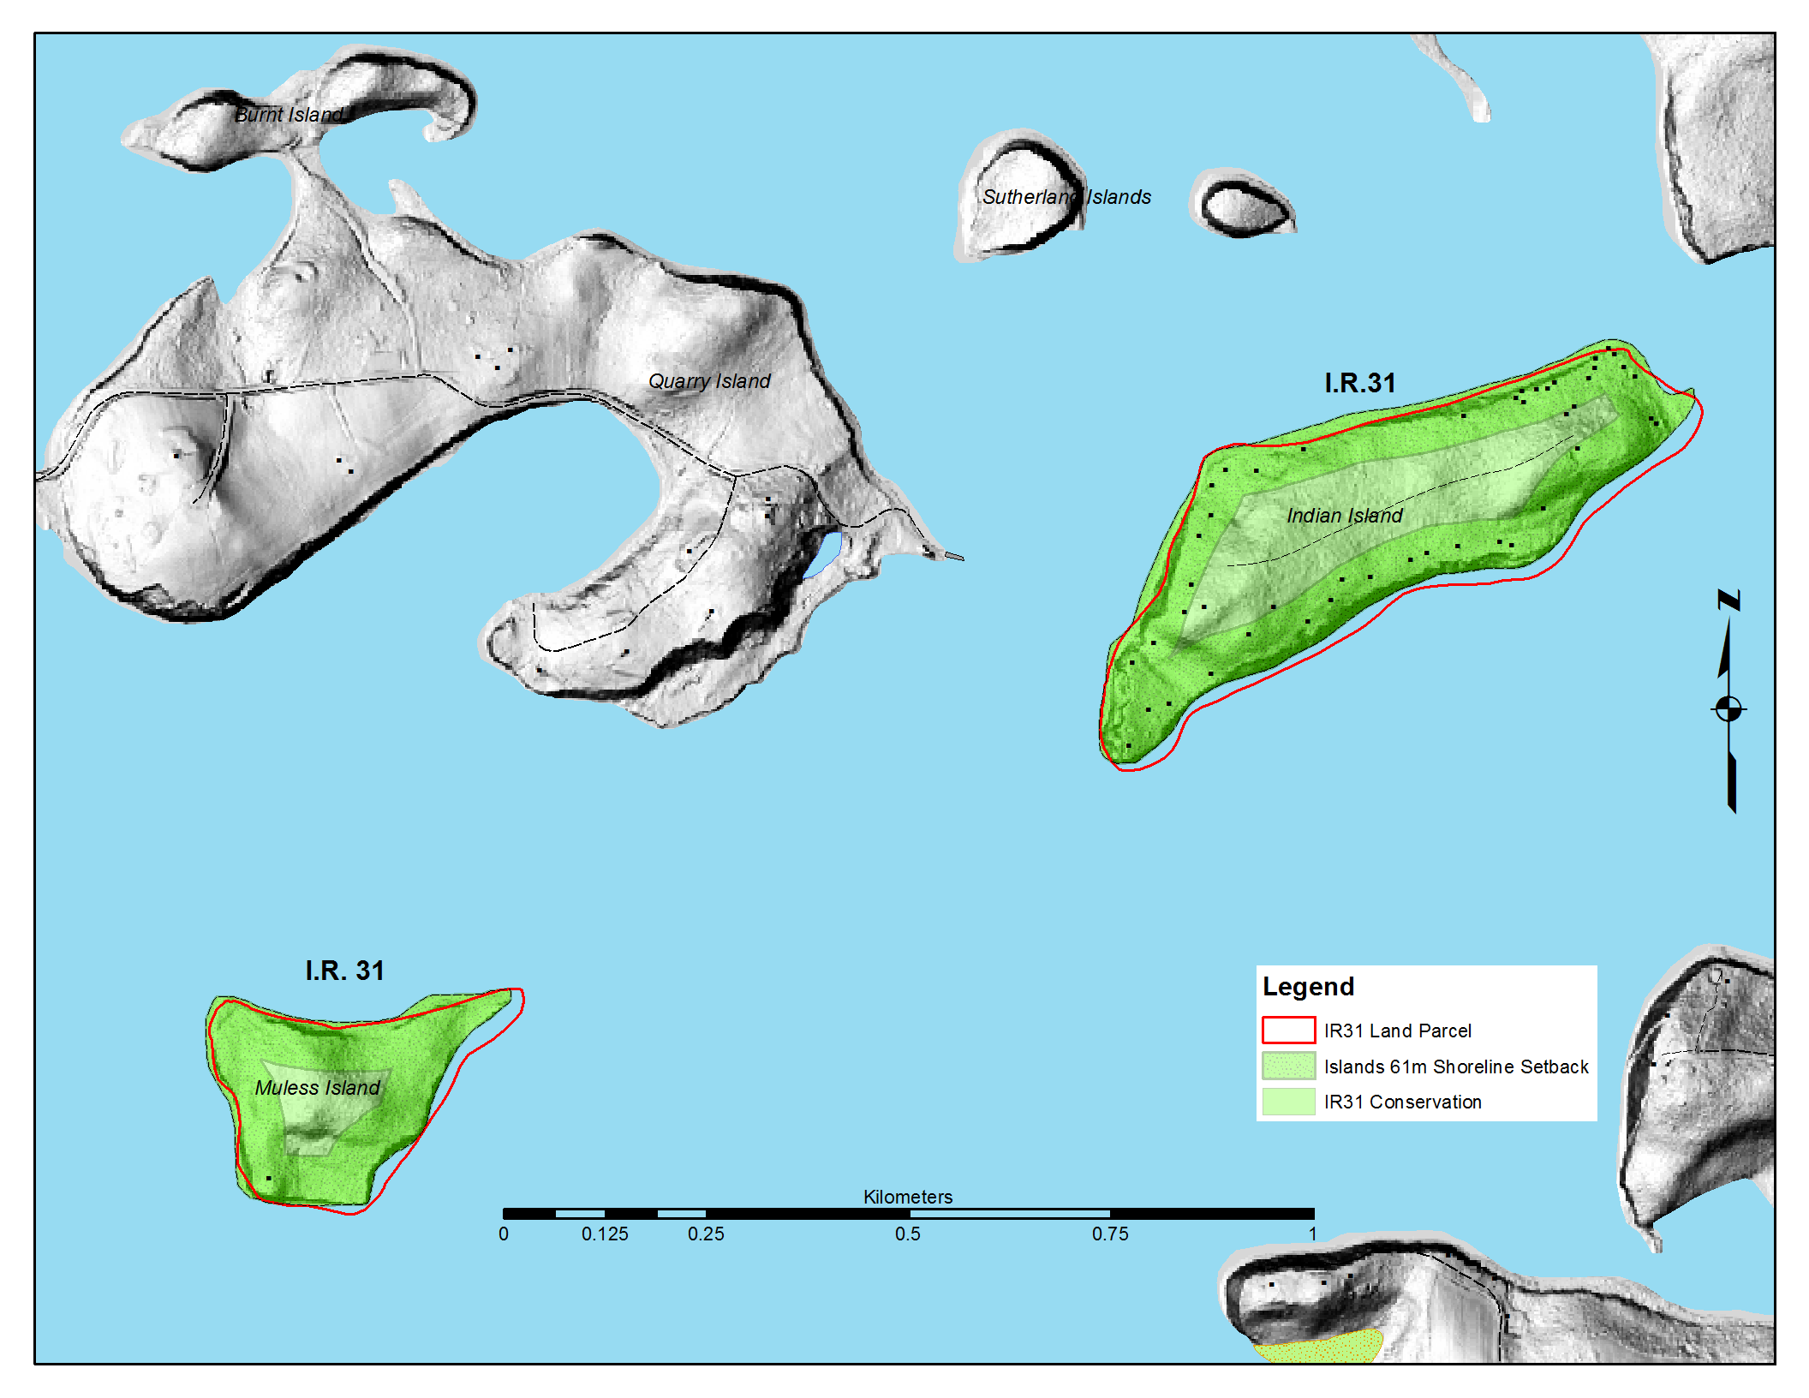
PLFN Pre-Planning Phase Activities
Proposed Future Land Use
Merigomish Islands

Slide 18
End Part 3

