Slide 1

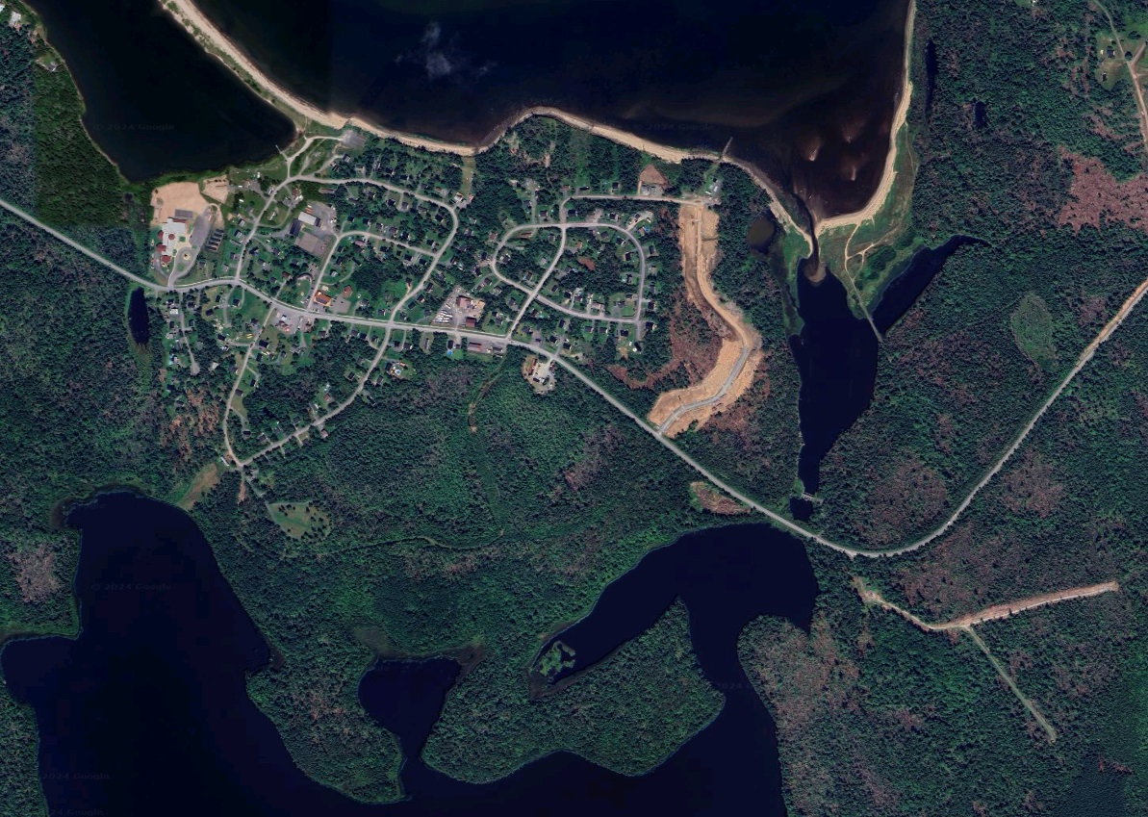
Pictou Landing First Nation
Land Use Plan 2024/2025
PLFN Pre-Planning Phase Activities
Part 2
Notes:
Thanks!

Slide 2
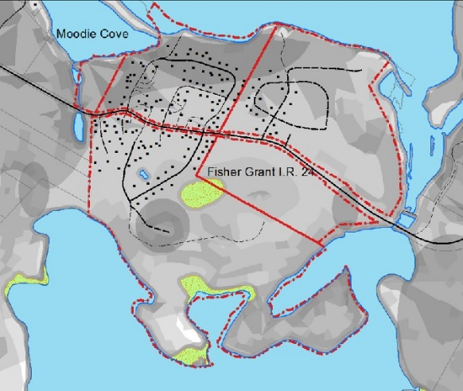
PLFN Pre-Planning Phase Activities
Land Analysis
Land Analysis Results
All of the Land Analysis Land Factors were analyzed using the Grey Tone Analysis Method, which was brought to prominence in the 1960s by Planner/Landscape Architect Ian McHarg as a precursor to the use of GIS analysis and remains relevant today.
The land analysis method uses the clear, light grey and dark grey to rate each Land Factor directly from the Land Analysis Criteria table (See Land Use Criteria Table). This land use plan uses:
Clear/White or lack of grey tone shading = “Good”,
Light grey = “Fair” or “Moderate” and
Dark grey = “Poor” suitability for each land factor rating based on criteria for each land use type.
Each land factor layer was assigned a transparency factor and overlaid with each other factor layer relevant to each land use type.
The Grey Tone result is a map of the accumulation of grey, darkening the least suitable areas for each land use type. Lighter or clear areas indicate more Suitable or supporting land conditions for each land use type. The Grey Tone map for each land use type marks the lighter areas as “Hot Spots” of more suitable supporting land conditions, and is taken into consideration in establishing Future Land Use Zones.
Residential Analysis Sample

Slide 3
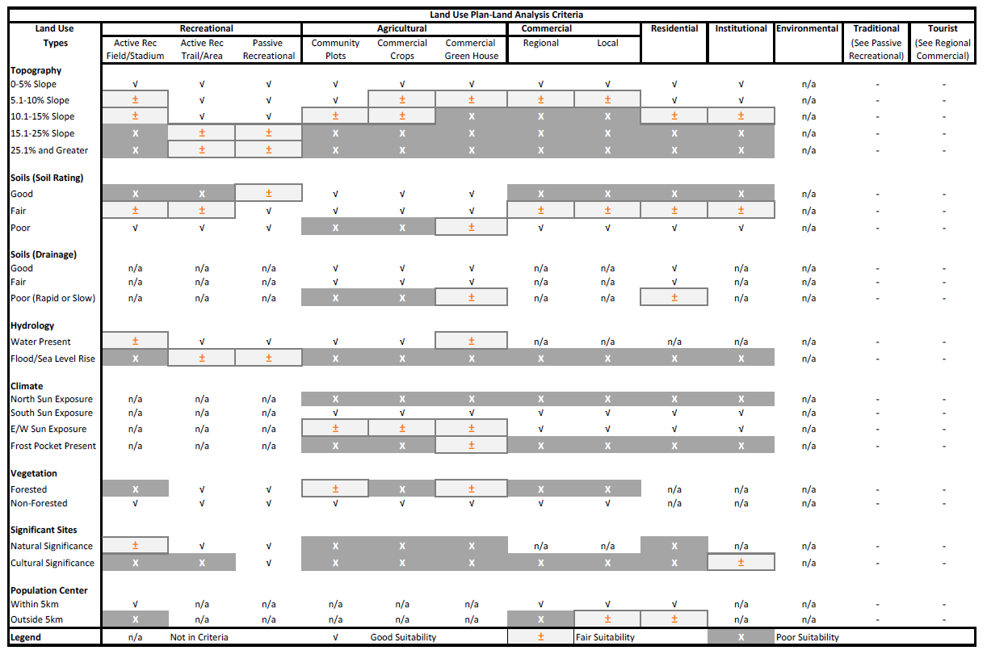
PLFN Pre-Planning Phase Activities
Draft Land Use Type and Land Matching Criteria

Slide 4
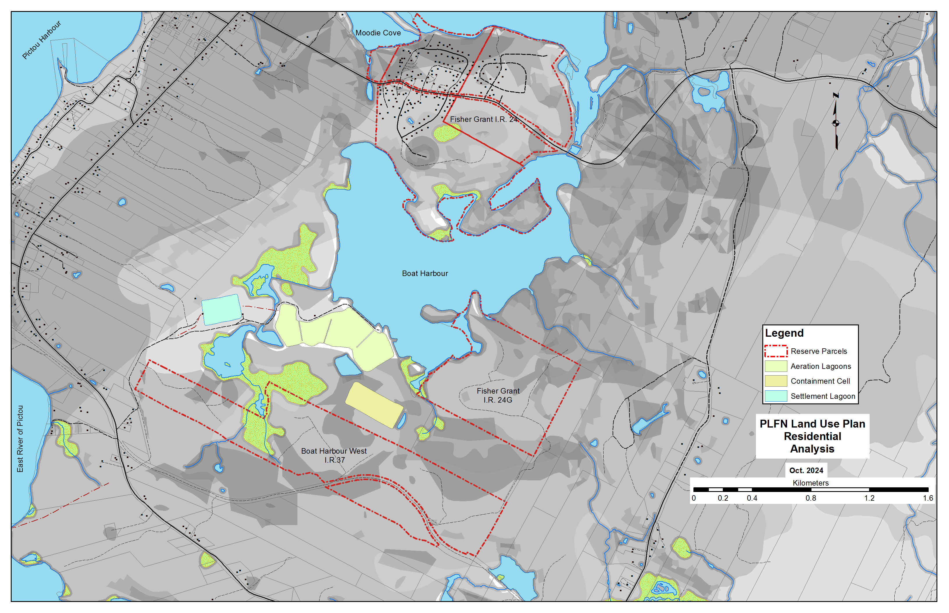
PLFN Pre-Planning Phase Activities
Land Analysis

Slide 5
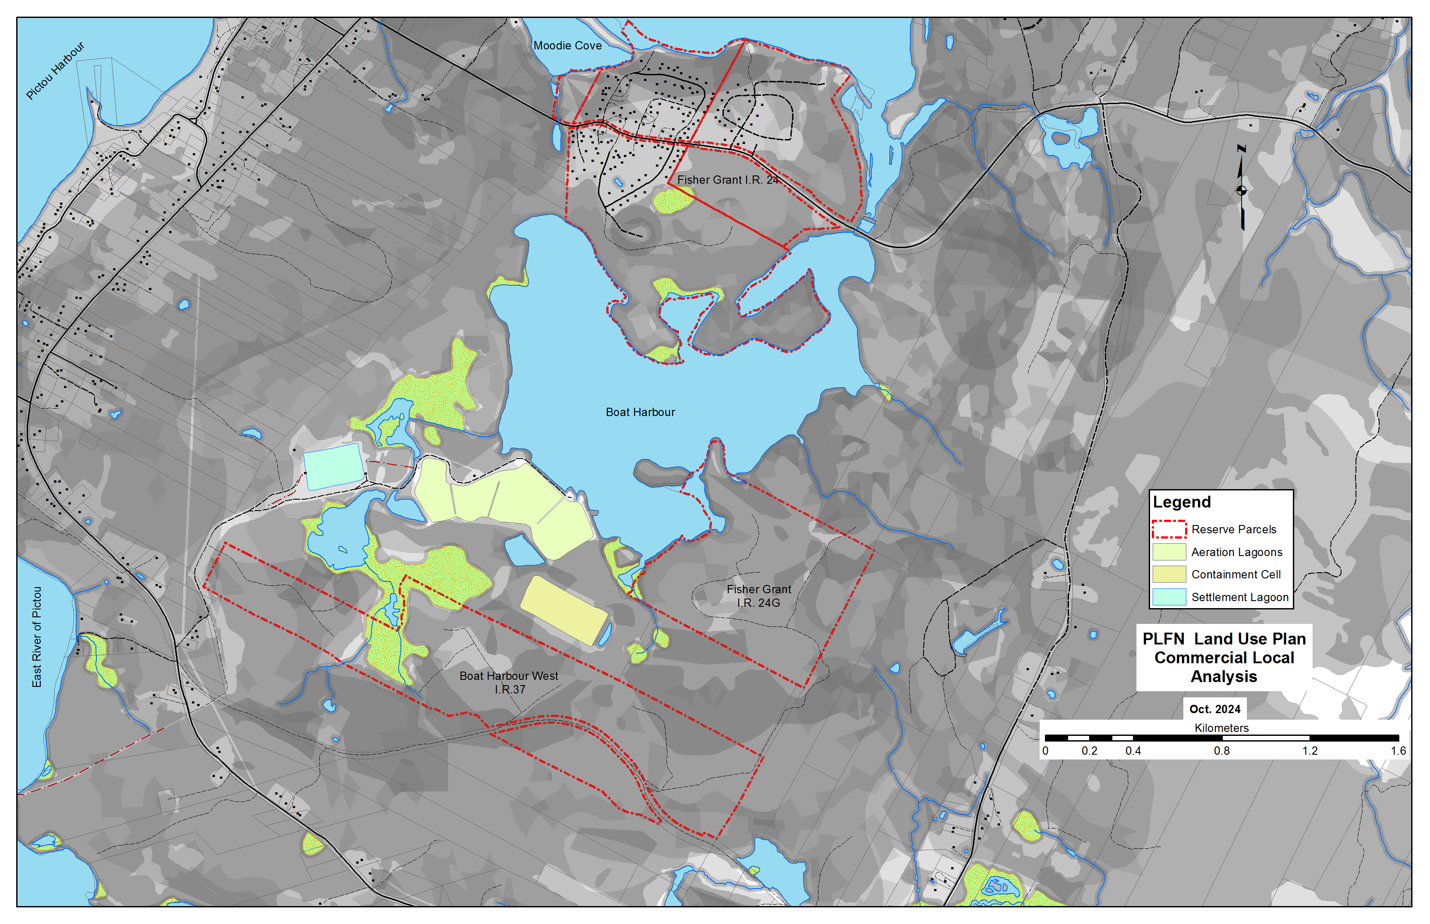
PLFN Pre-Planning Phase Activities
Land Analysis

Slide 6
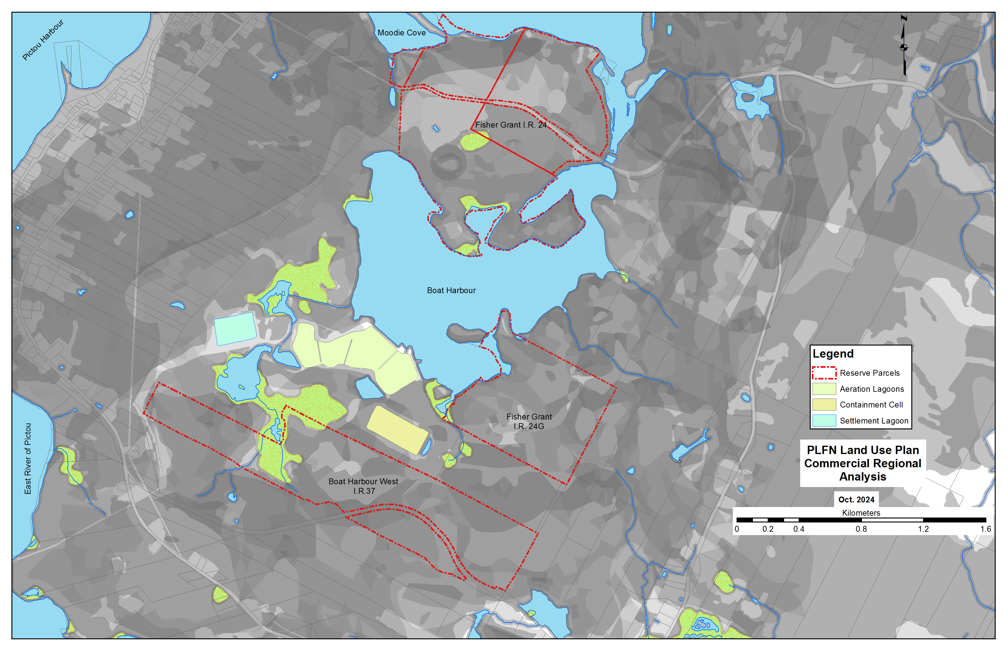
PLFN Pre-Planning Phase Activities
Land Analysis

Slide 7
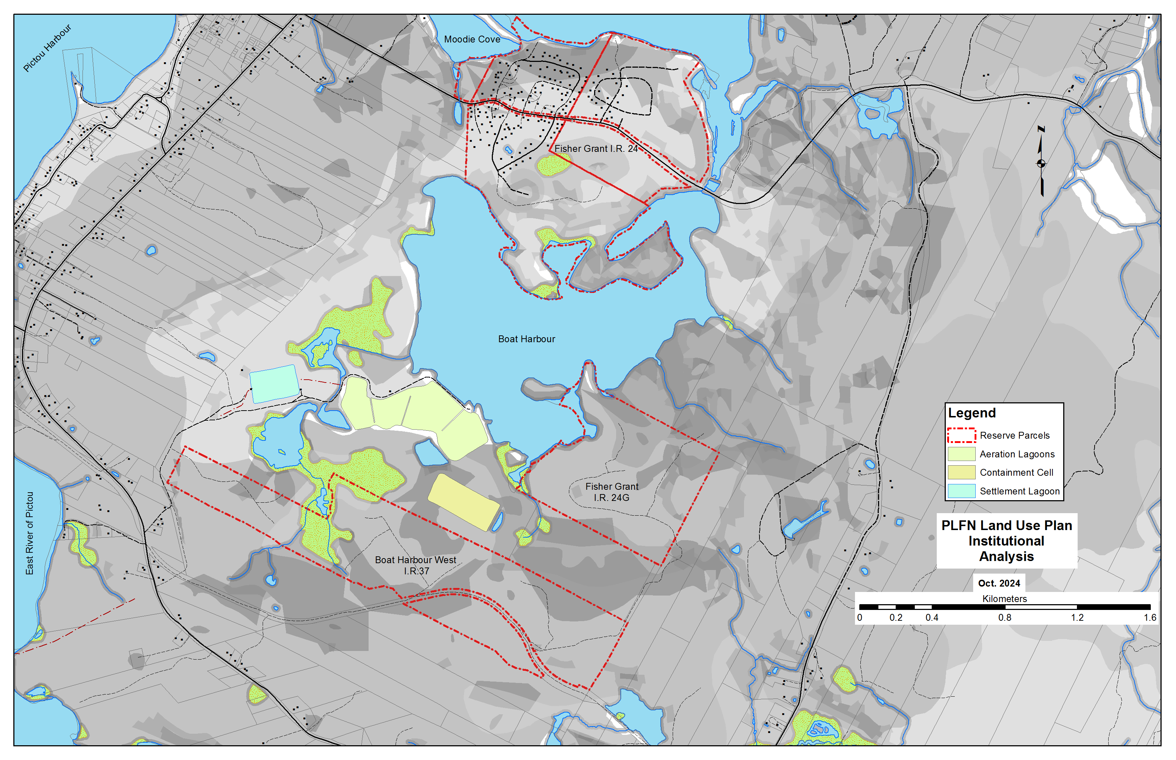
PLFN Pre-Planning Phase Activities
Land Analysis

Slide 8
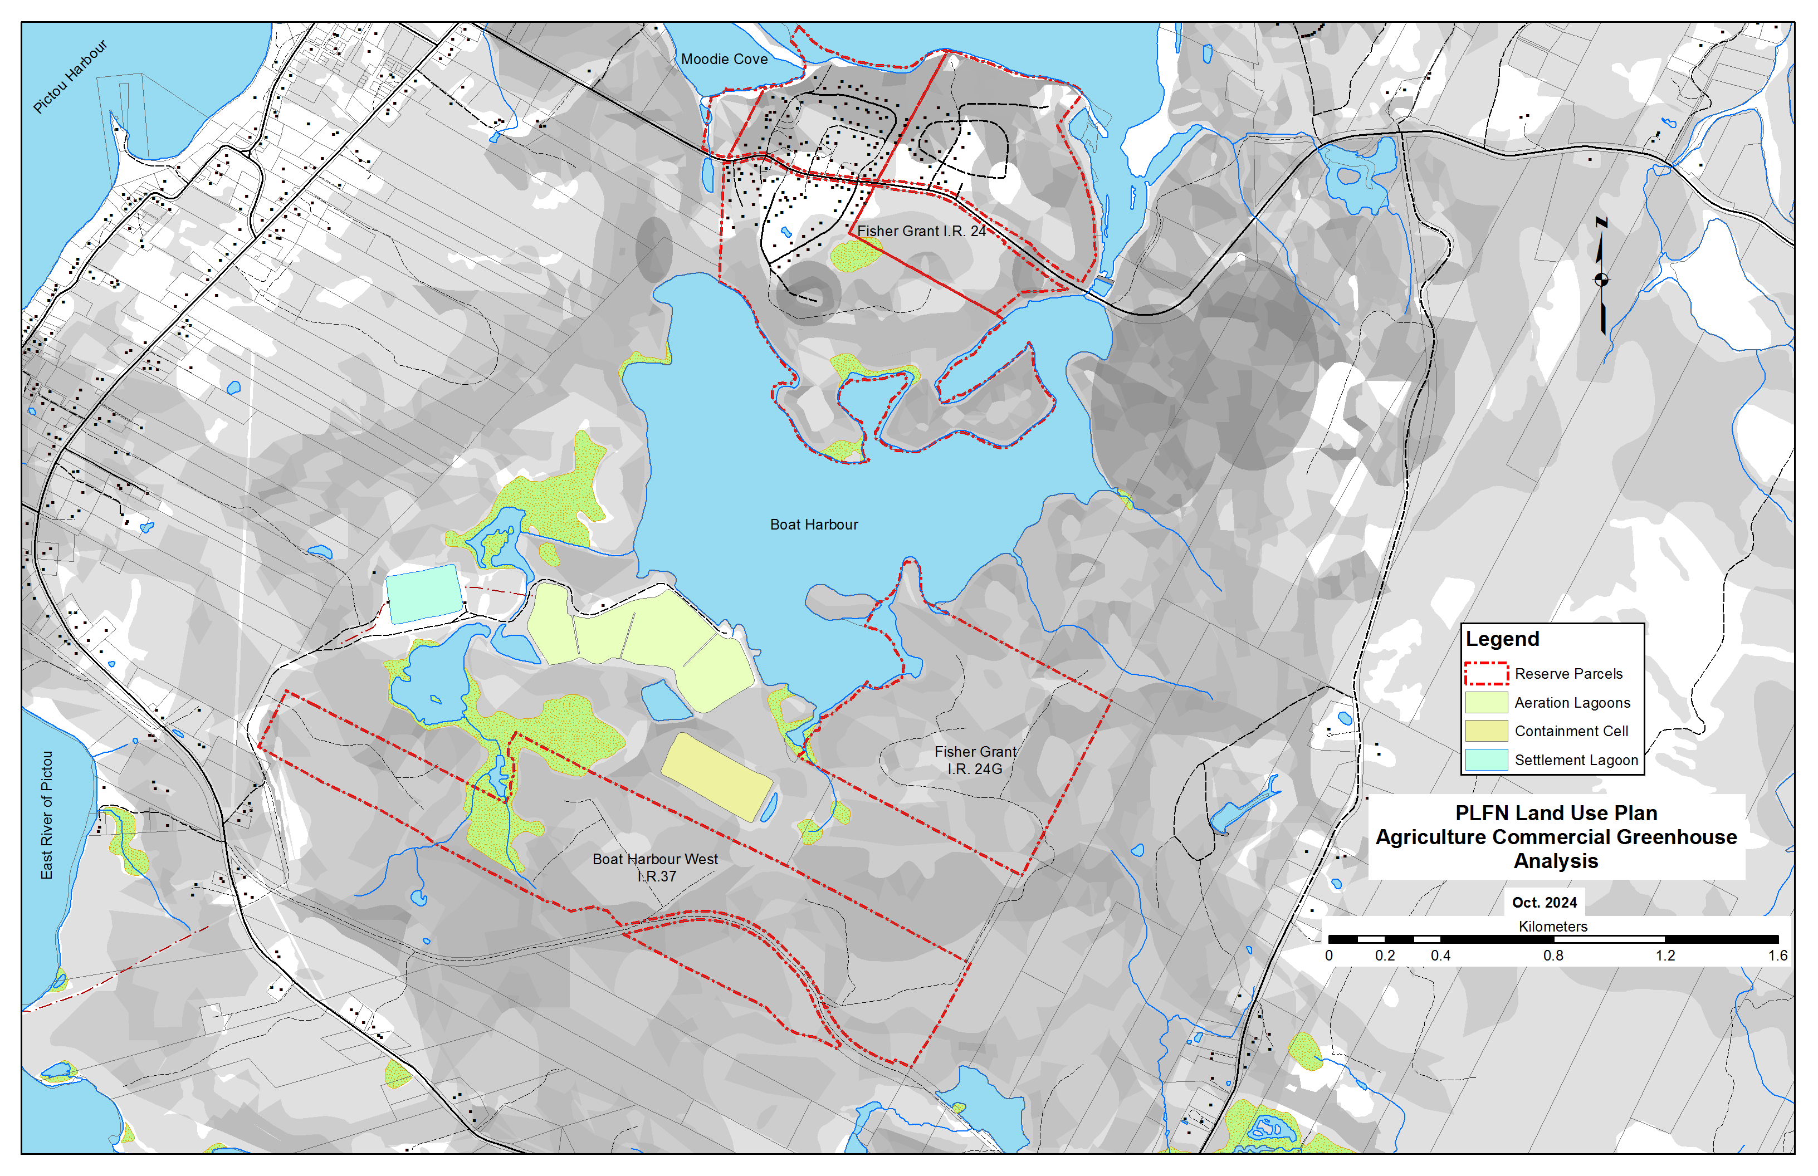
PLFN Pre-Planning Phase Activities
Land Analysis

Slide 9
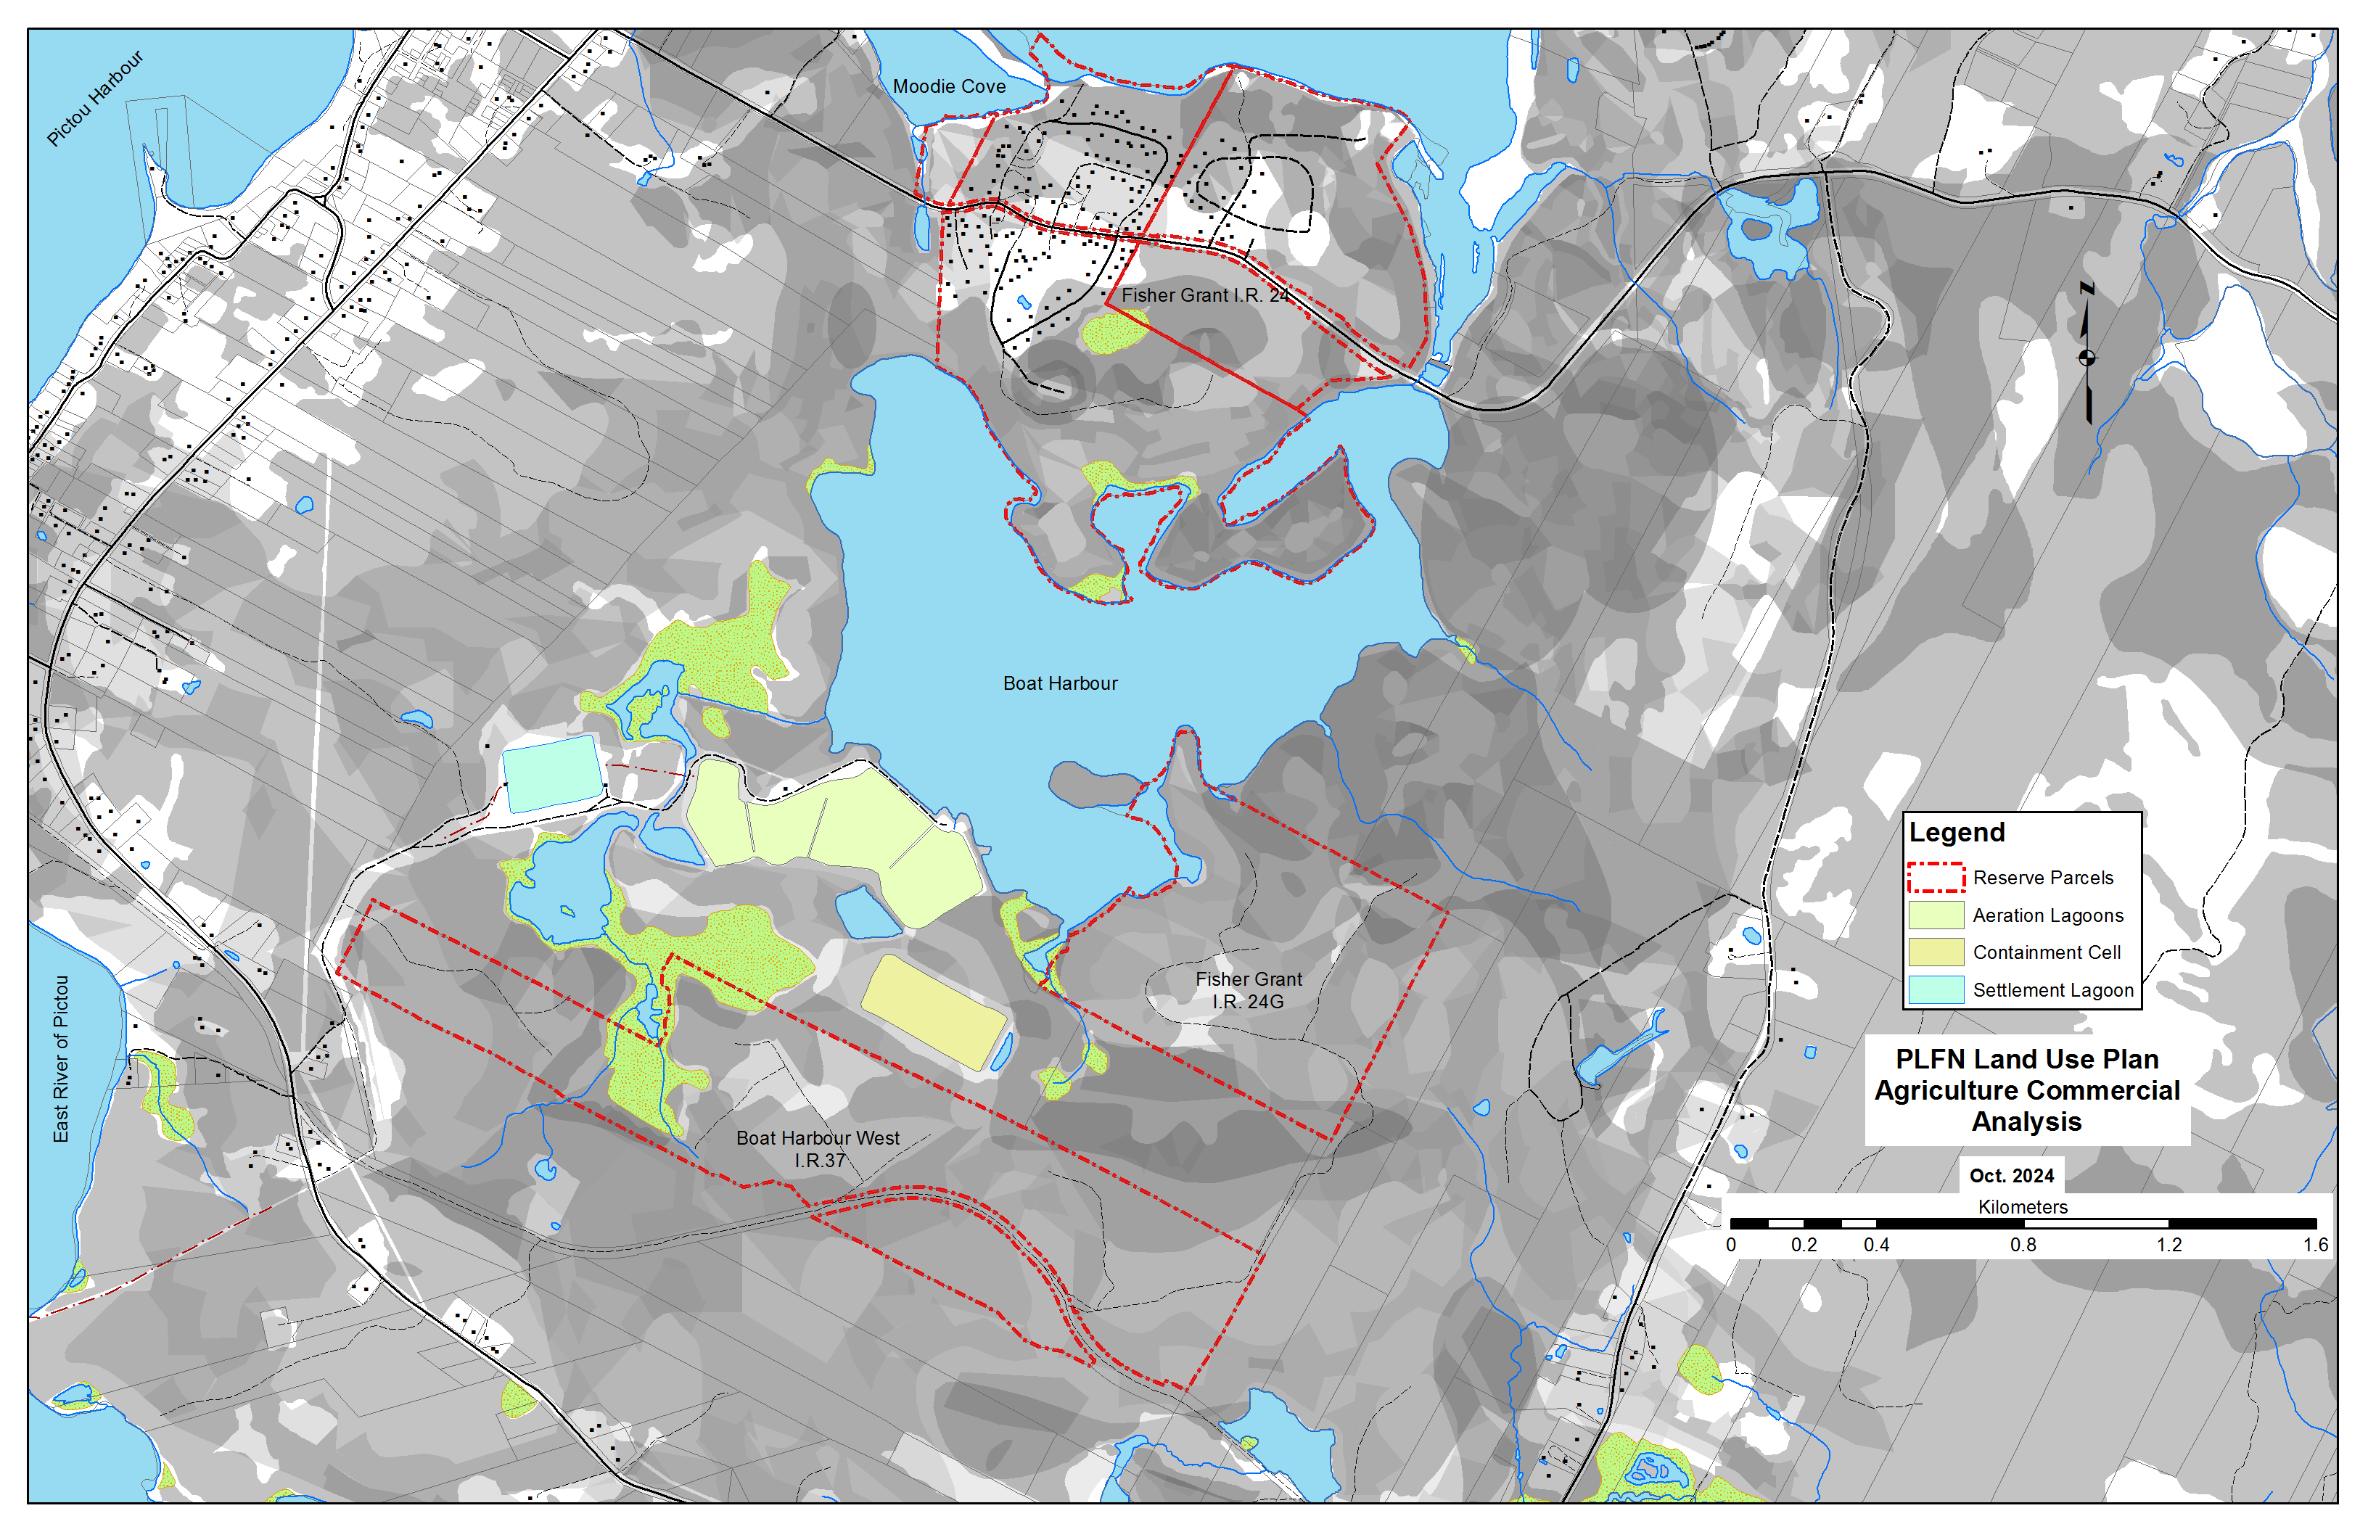
PLFN Pre-Planning Phase Activities
Land Analysis

Slide 10
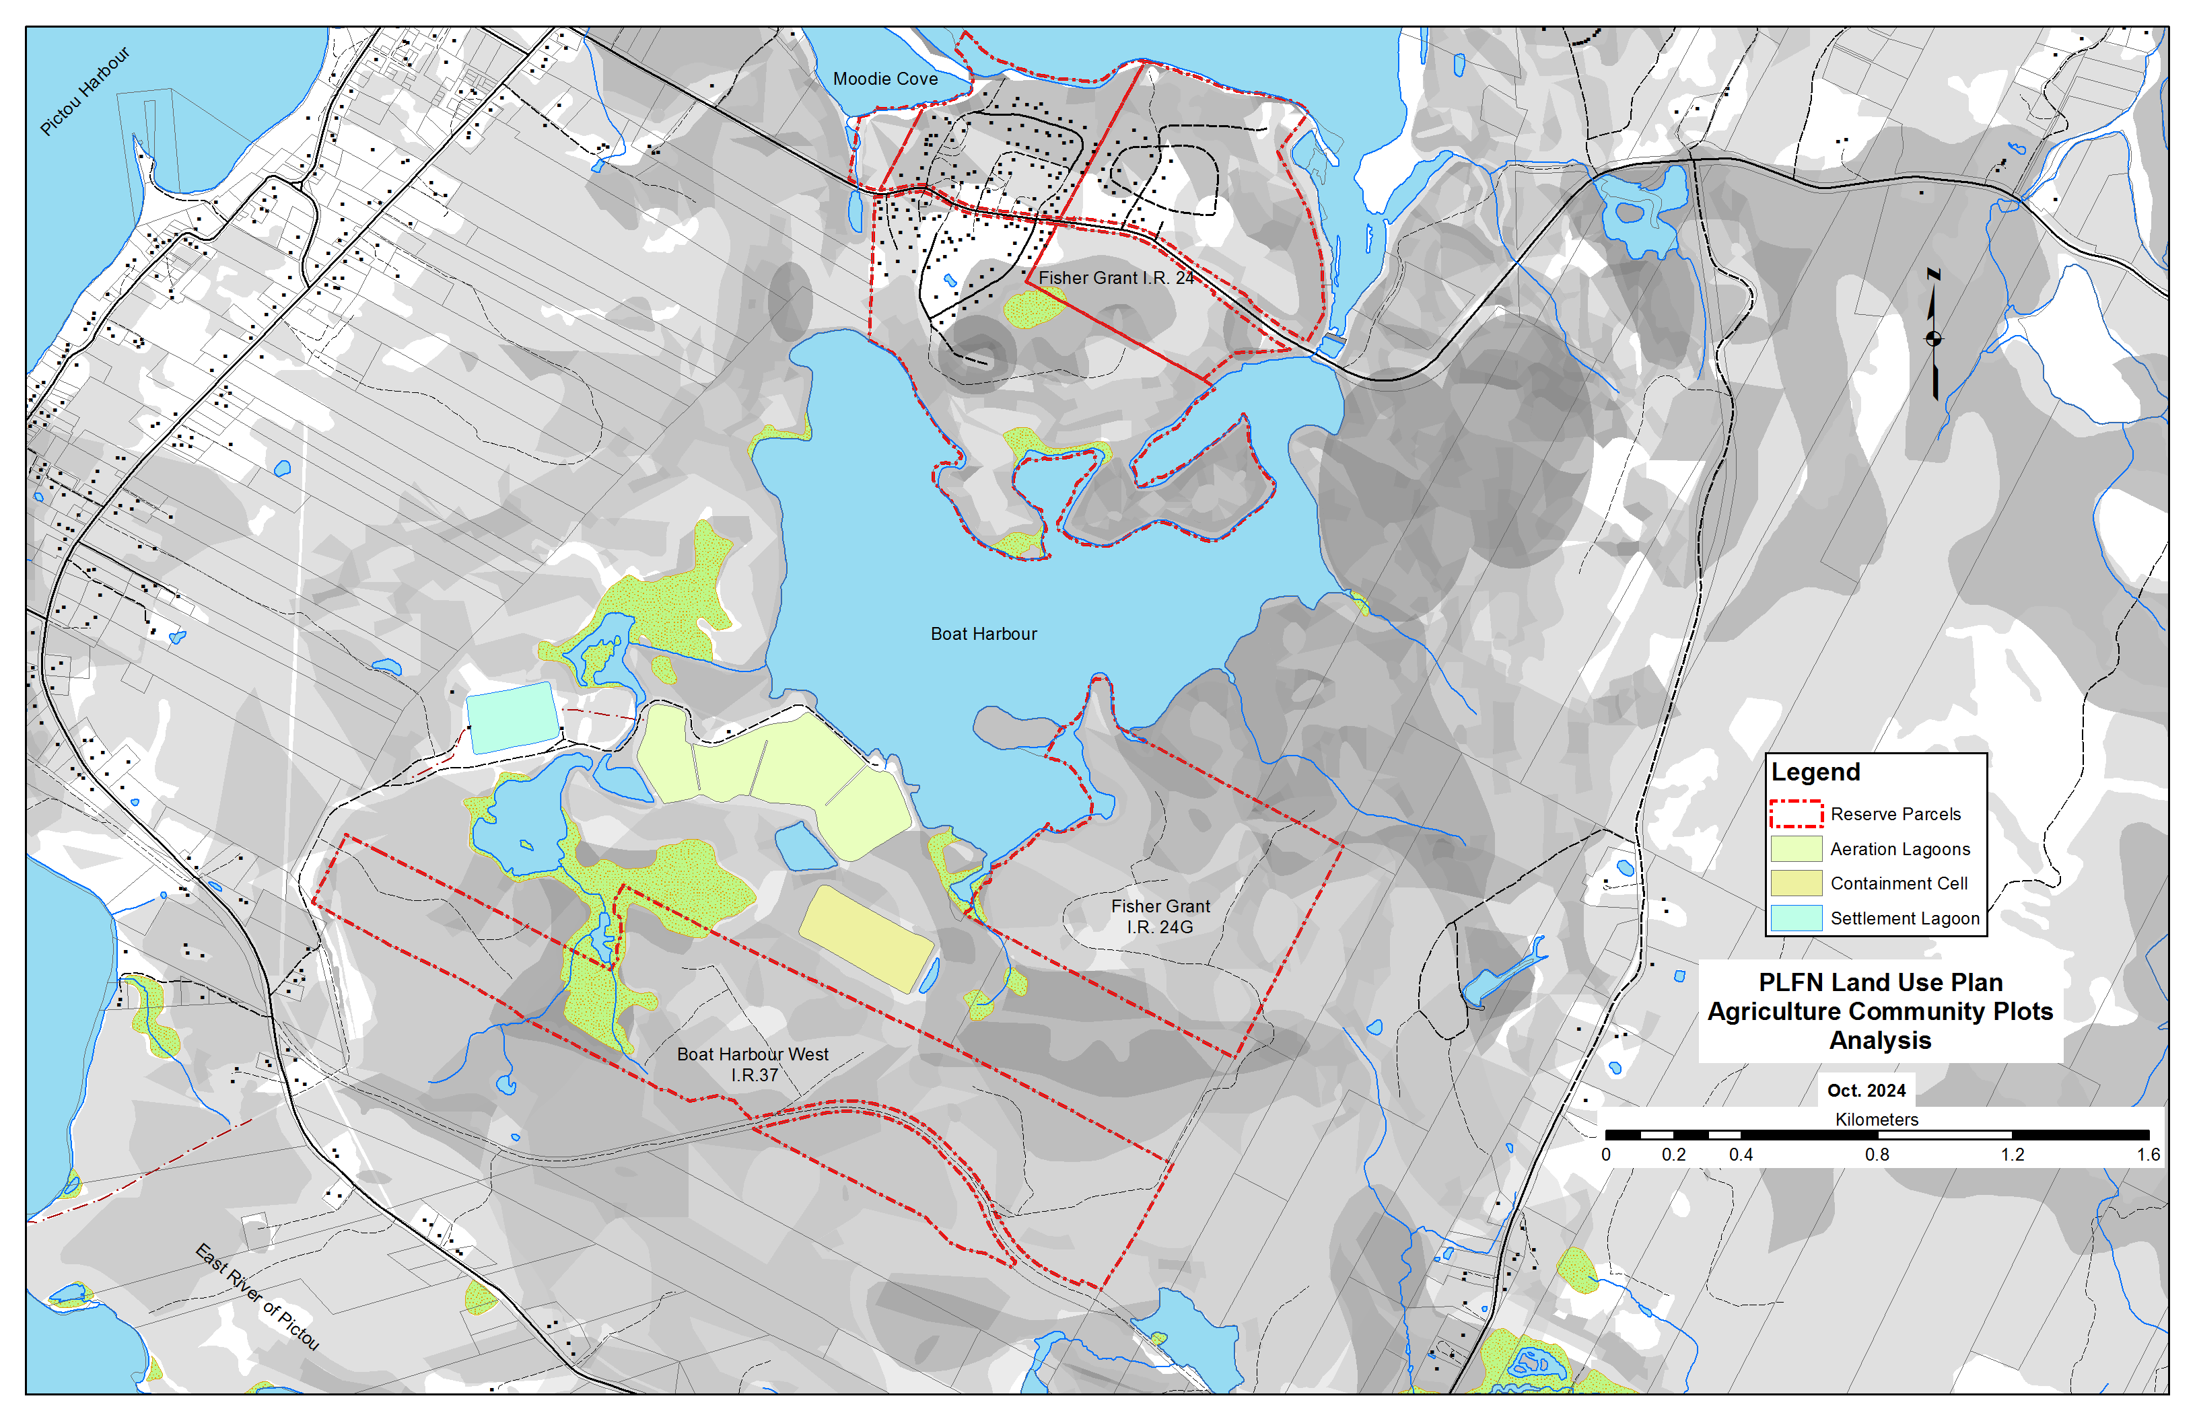
PLFN Pre-Planning Phase Activities
Land Analysis

Slide 11
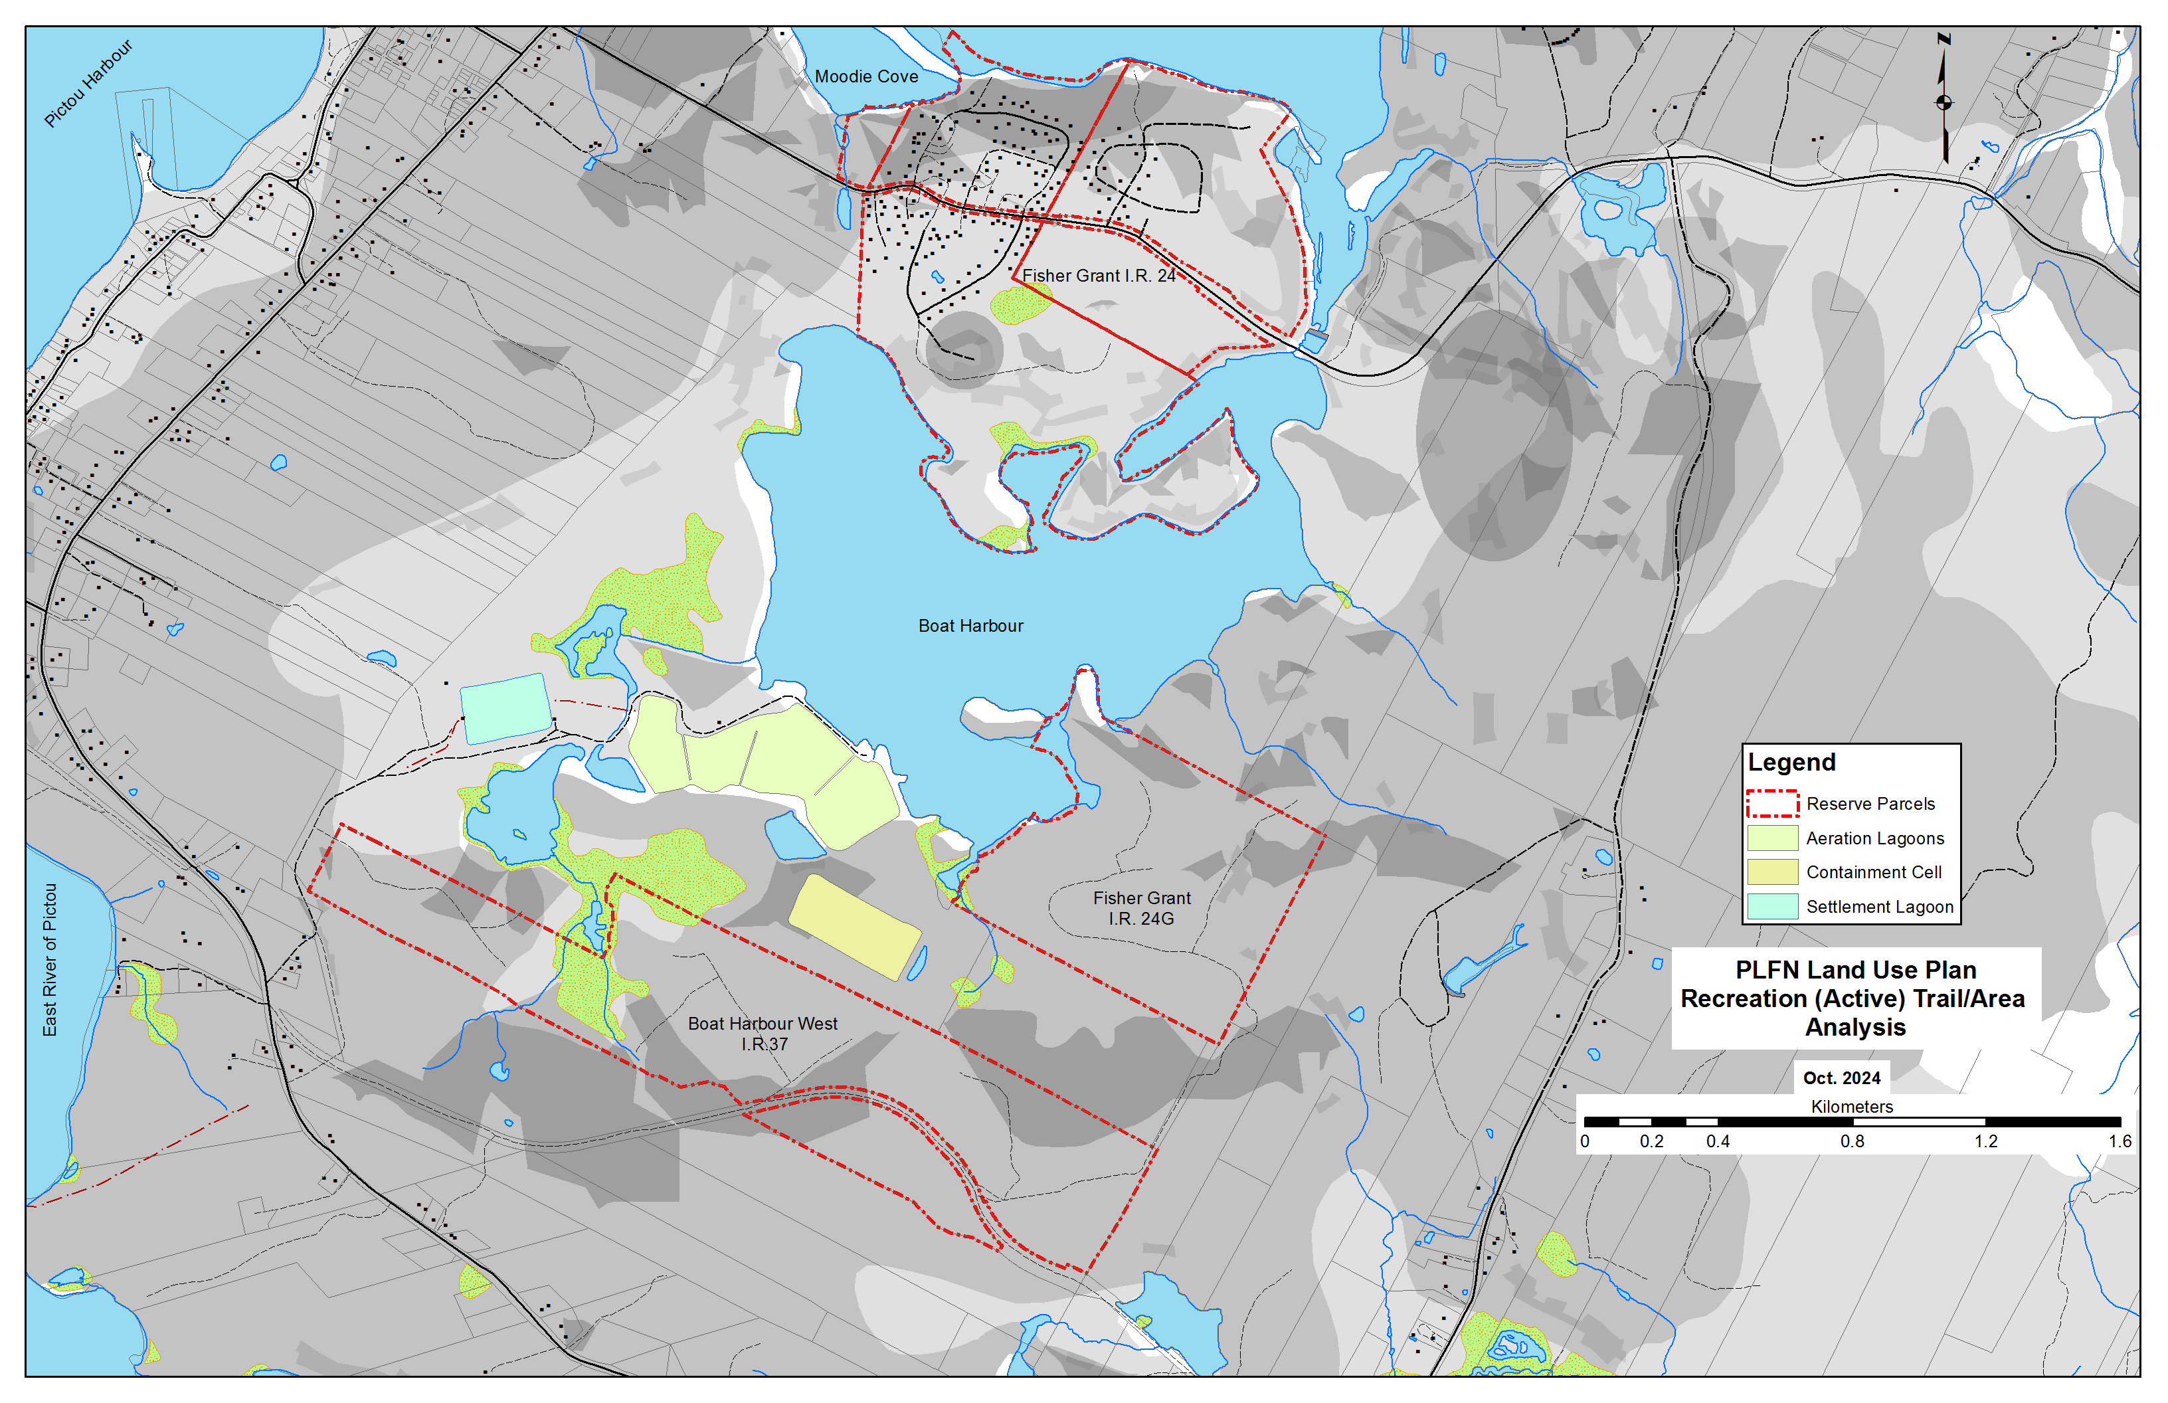
PLFN Pre-Planning Phase Activities
Land Analysis

Slide 12
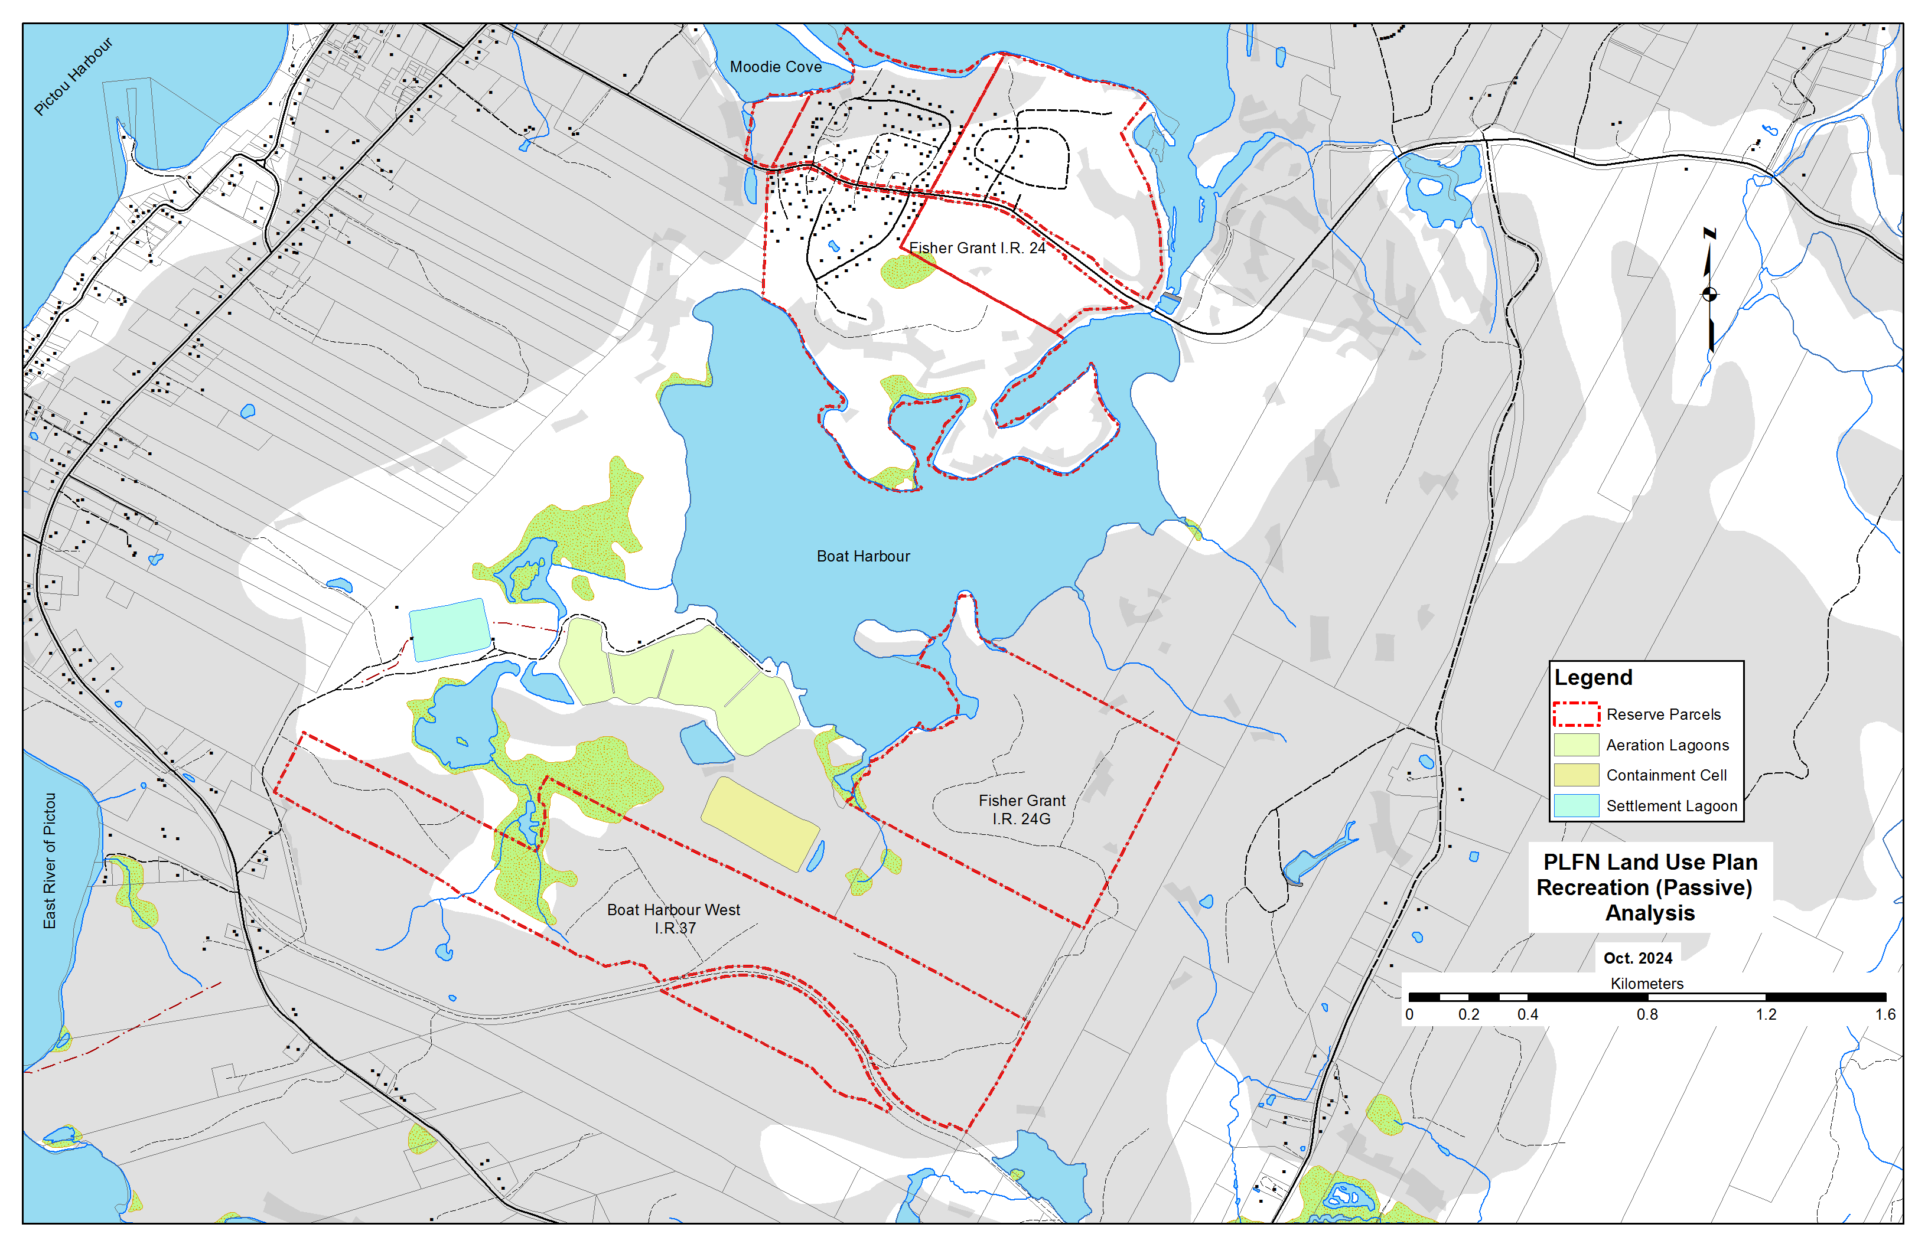
PLFN Pre-Planning Phase Activities
Land Analysis

Slide 13

End Part 2

