Slide 1

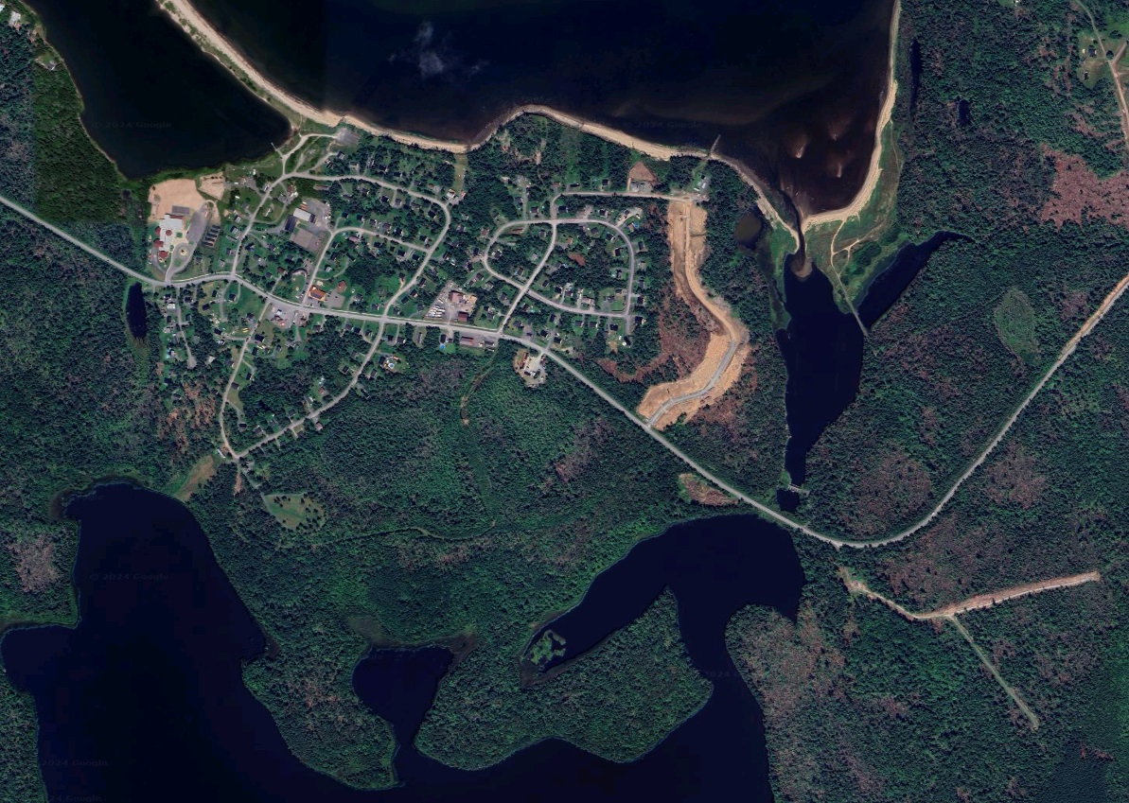
Pictou Landing First Nation
Land Use Plan 2024/2025
Part 1
Notes:
Cover Image showing Satellite Image of New development on Membertou

Slide 2
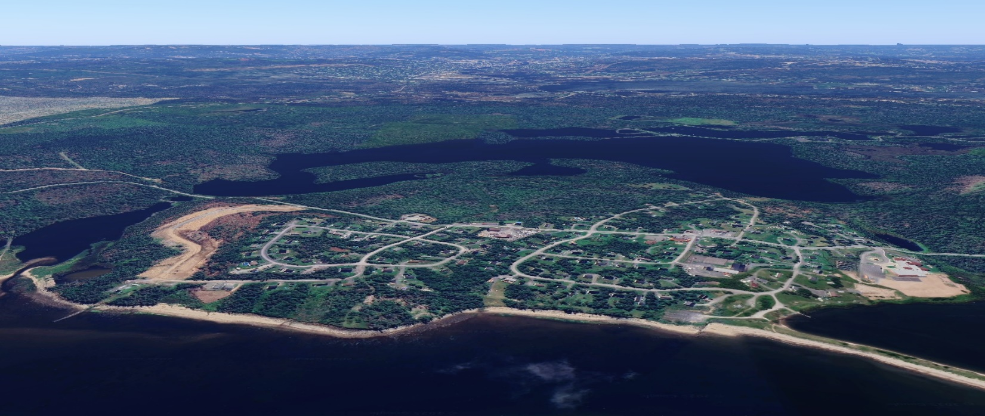
PLFN Pre-Planning Phase Activities
Vision
In the spring of 2024, PLFN began a Land Use Planning Process with funding provided by the National Aboriginal Land Managers Association (NALMA) under the Land Use Planning Funding Initiative Program.
Activities undertaken under the Pre-Planning Phase of the Land Use Planning Process included Background Research, Land Analysis, Community Surveys and drafting Future Land Use Plan Options

Slide 3
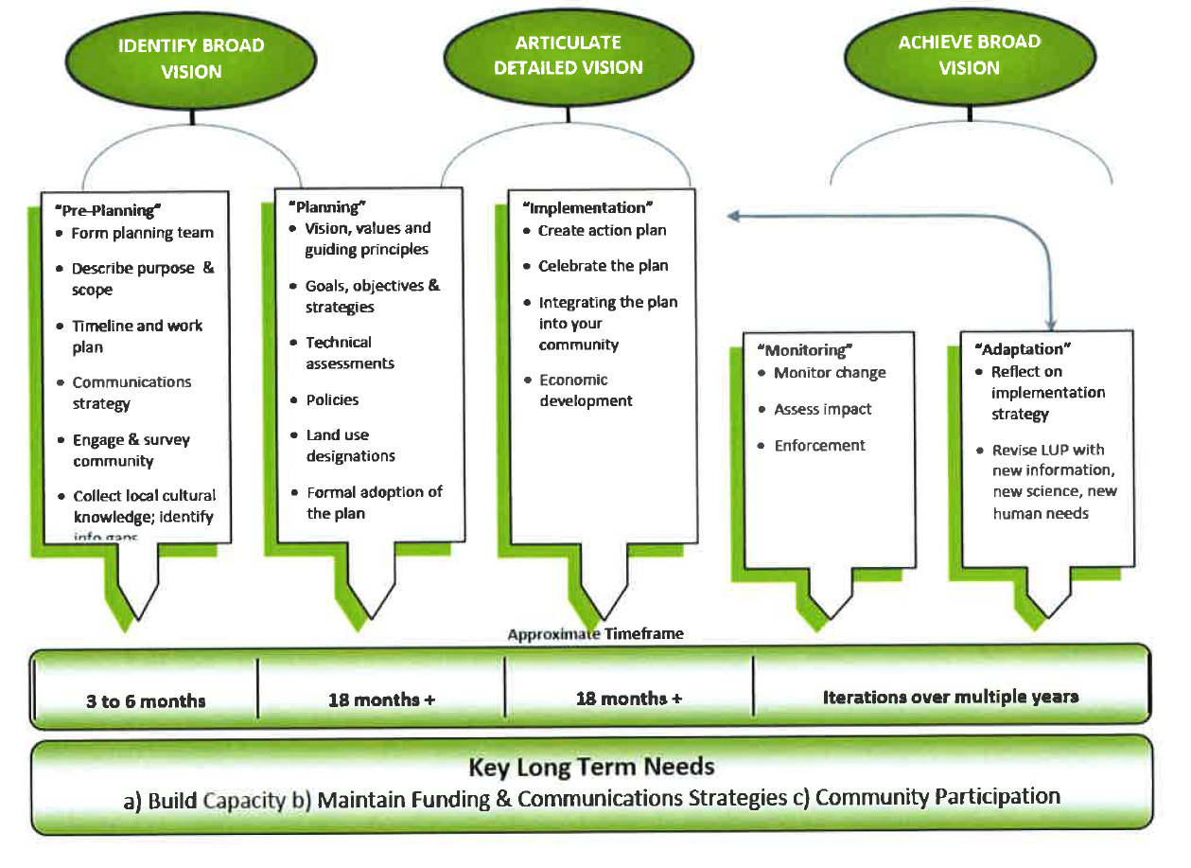
PLFN Pre-Planning Phase Activities
Planning Model
EcoTrust/NALMA model
This Phase
Monitor
Community Engagement Pre-Planning Phase
Notes:
General DISC Planning Model showing what Phase the following community engagement results to be presented were derived.

Slide 4
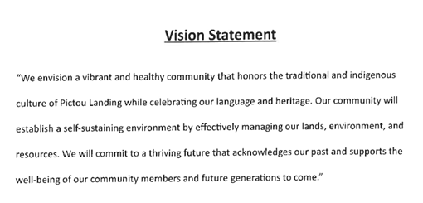
PLFN Pre-Planning Phase Activities
PLFN Planning Vision
Key Words:
Vibrant and healthy
Honours and celebrates Indigenous (Mi’kmaw) culture
Self-sustaining environment
Effectively managing our lands
Acknowledging the past
Committing to a thriving future

Slide 5
PLFN Pre-Planning Phase Activities
Vision
Key Pre-Planning Activities:
Form PLFN Planning Committee/Team selected from PLFN Departments, Council and Volunteers
Hire a PLFN Planning Assistant from the community to plan events/activities, collect and input data
Administer and Analyze PLFN Land Use Plan Community Survey
Map Land Analysis Results and Match Land Use Types with Suitable Land
Draft Three (3) Proposed Future Land Use Plan Options
Compile Background Report

Slide 6
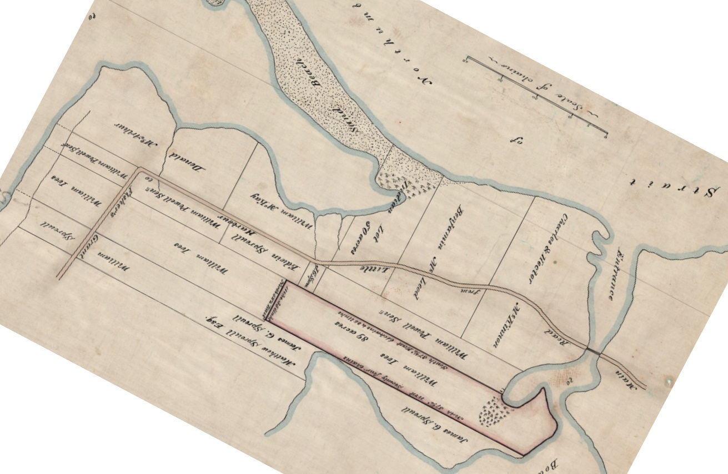
PLFN Pre-Planning Phase Activities
Research
PLFN Original 50-acre Parcel 1873

Slide 7
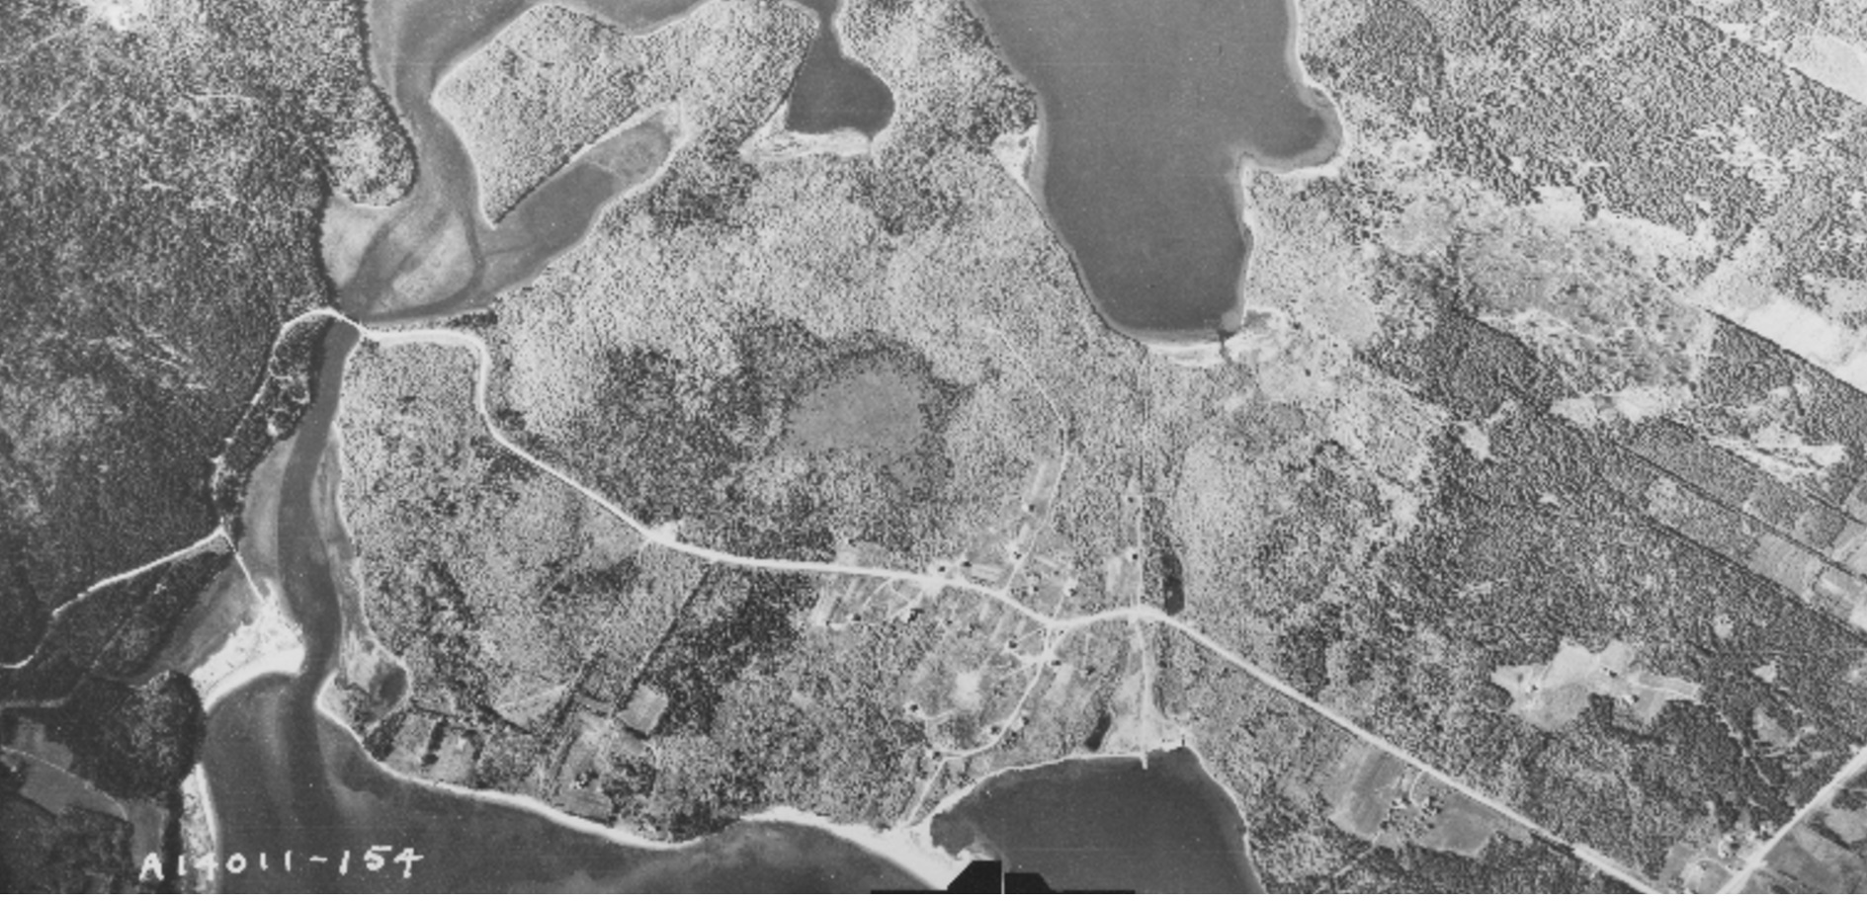
PLFN Pre-Planning Phase Activities
Pictou Landing
1954

Slide 8
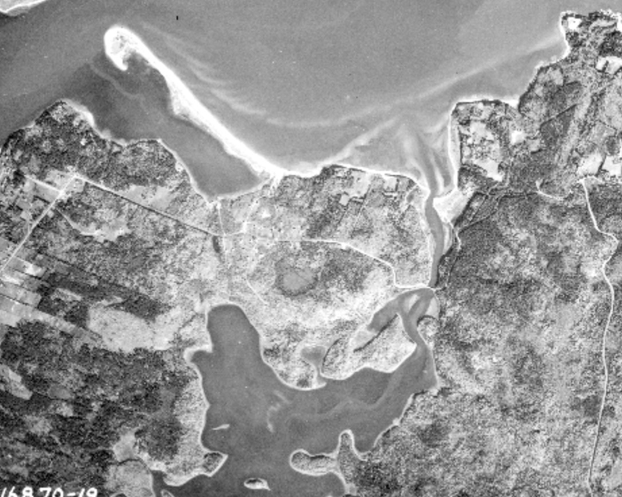
PLFN Pre-Planning Phase Activities
Pictou Landing
1959

Slide 9
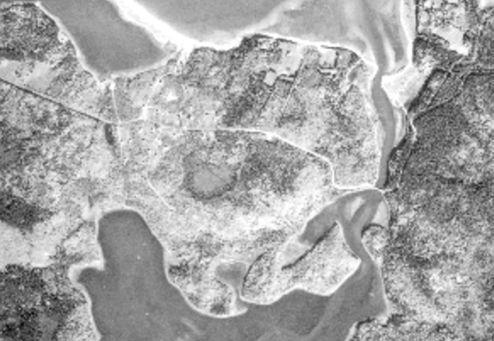
PLFN Pre-Planning Phase Activities
Pictou Landing
1959 Zoom

Slide 10
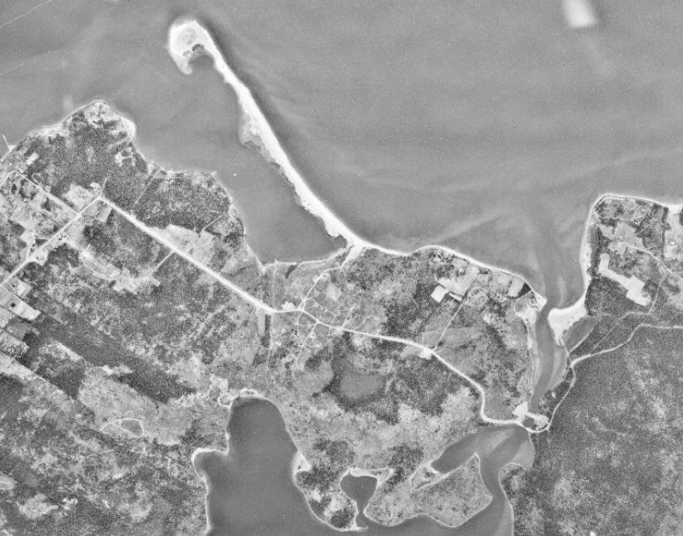
PLFN Pre-Planning Phase Activities
Pictou Landing
1967

Slide 11
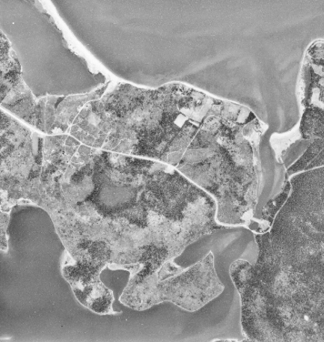
PLFN Pre-Planning Phase Activities
Pictou Landing
1967 Zoom

Slide 12
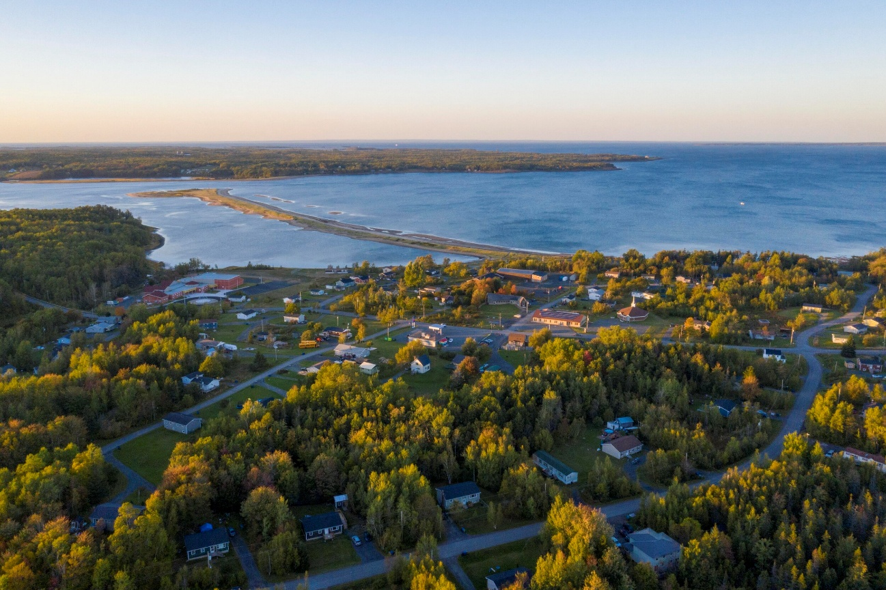
PLFN Pre-Planning Phase Activities
PLFN Stats
Community Background Information

Slide 13

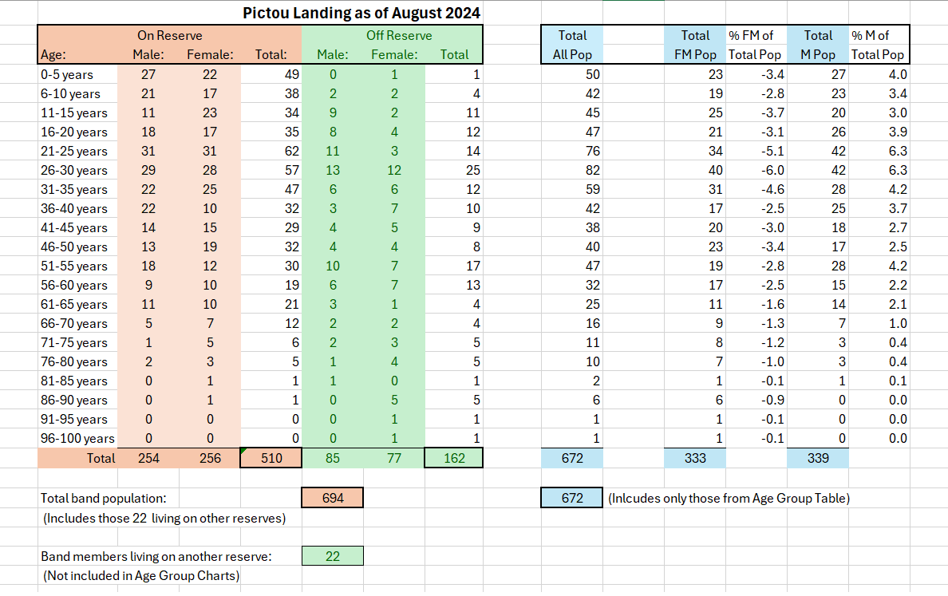
PLFN Pre-Planning Phase Activities
Research
PLFN Population
Source: PLFN/CMM

Slide 14
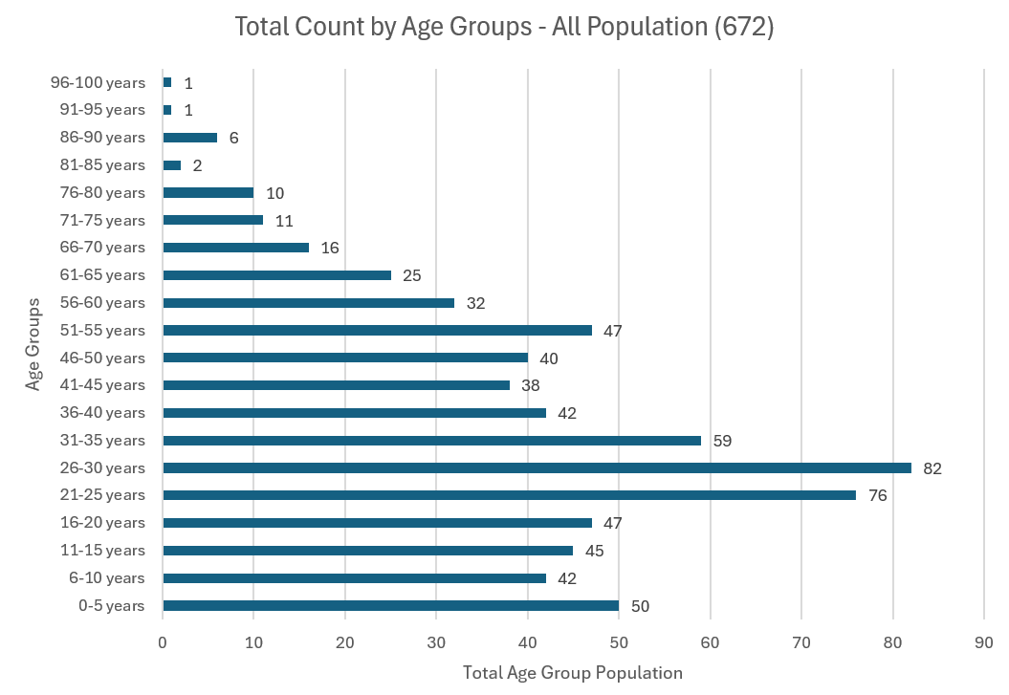
PLFN Pre-Planning Phase Activities
Research
PLFN Population
Source: PLFN/CMM

Slide 15
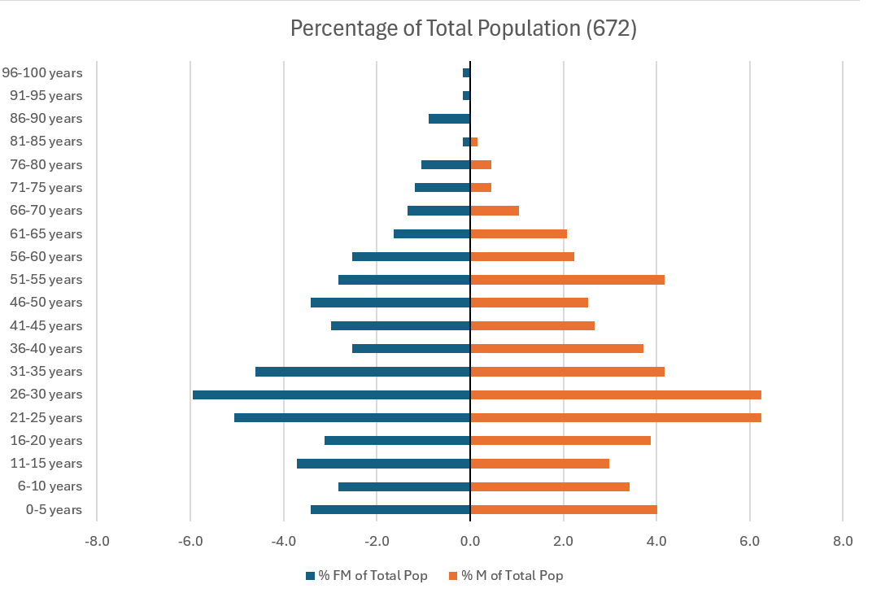
PLFN Pre-Planning Phase Activities
Research
PLFN Population
Females
Males
Source: PLFN/CMM

Slide 16
PLFN Pre-Planning Phase Activities
Current Land Use/Forest Management Plan
Notes:
Thanks!

Slide 17
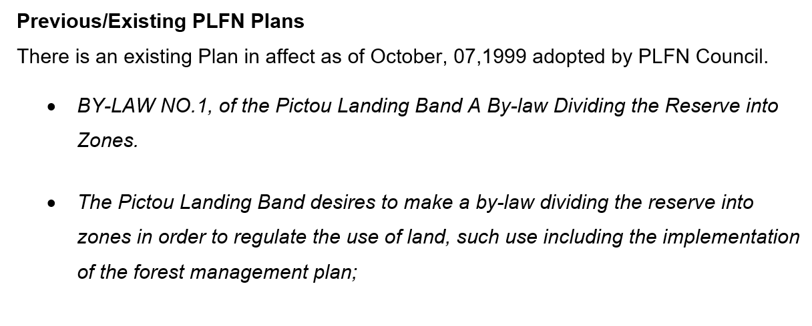
PLFN Pre-Planning Phase Activities
Current Land Use/Forest Management Plan
IR 24
Notes:
Thanks!

Slide 18
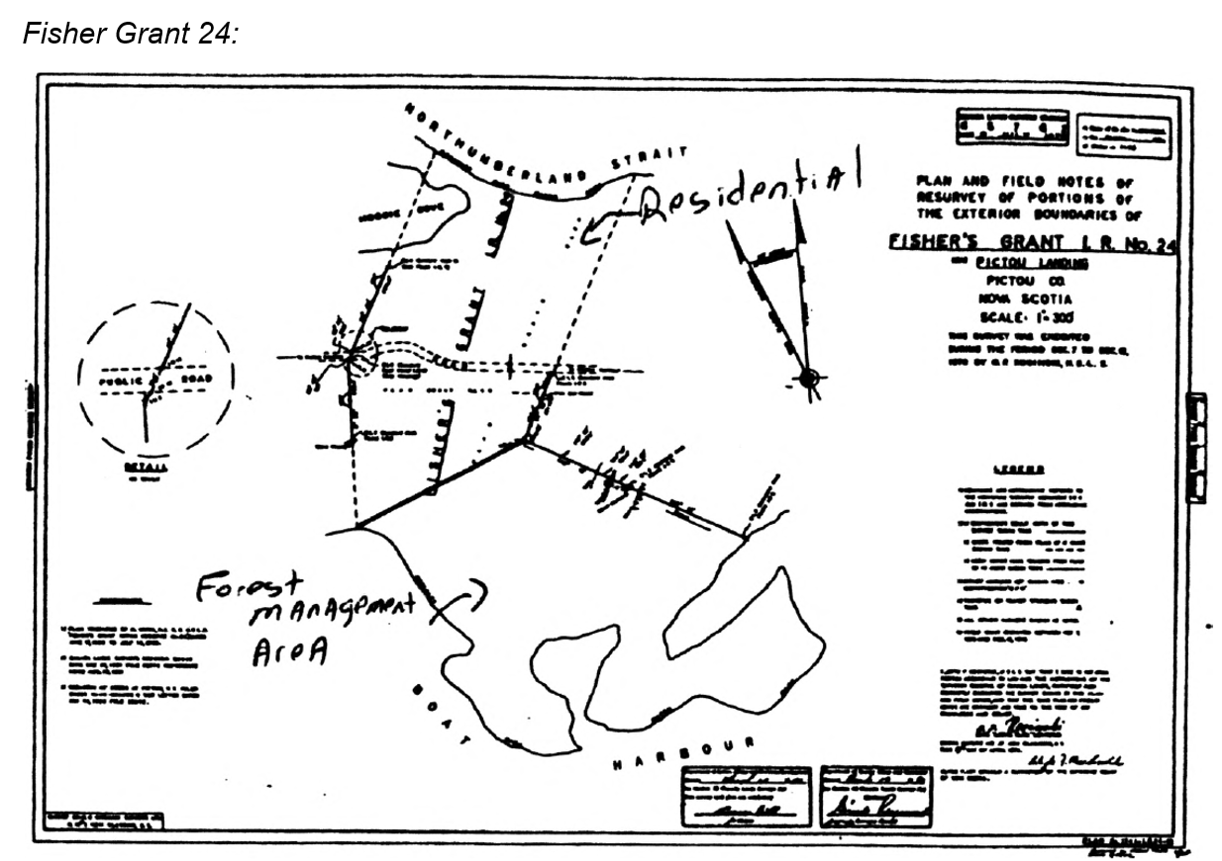
PLFN Pre-Planning Phase Activities
Current Land Use/Forest Management Plan
IR 24

Slide 19
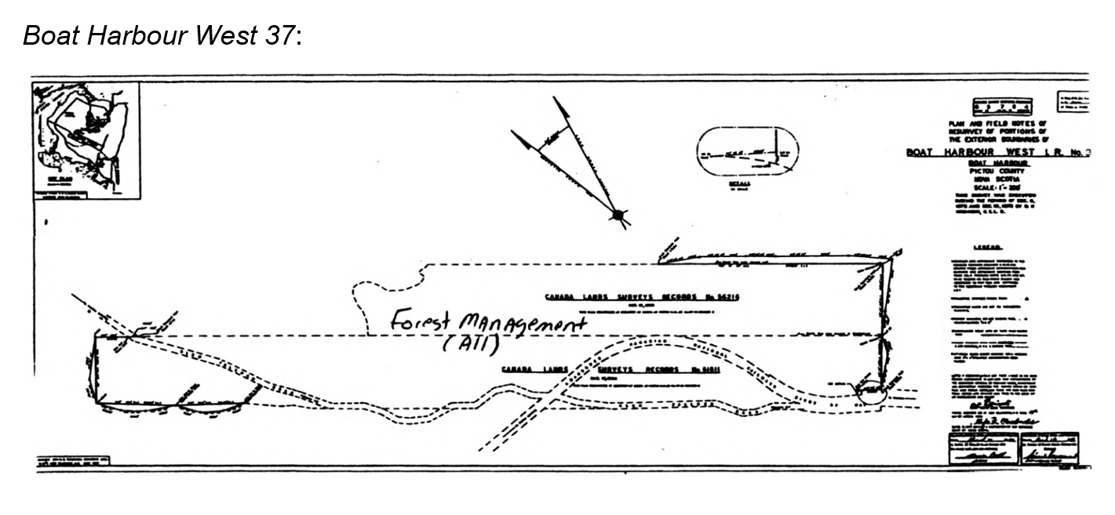
PLFN Pre-Planning Phase Activities
Current Land Use/Forest Management Plan
IR 37

Slide 20
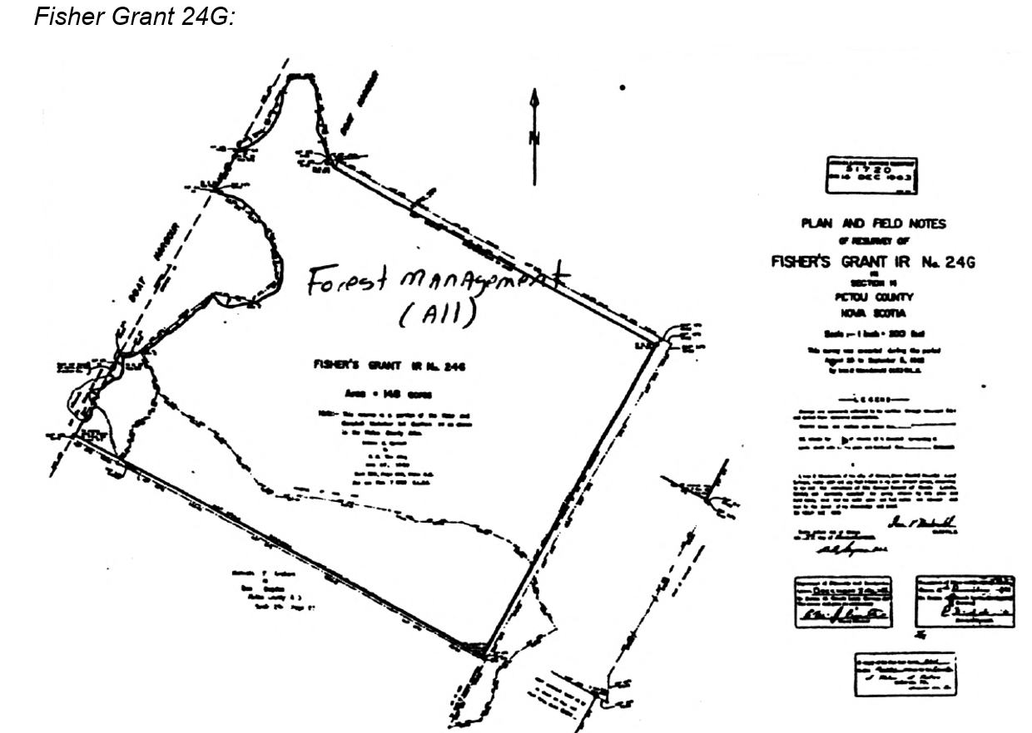
PLFN Pre-Planning Phase Activities
Current Land Use/Forest Management Plan
IR 24G

Slide 21
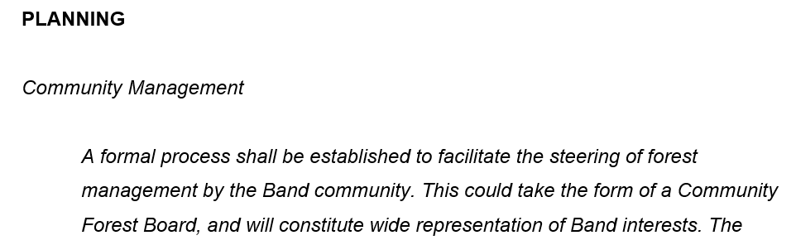
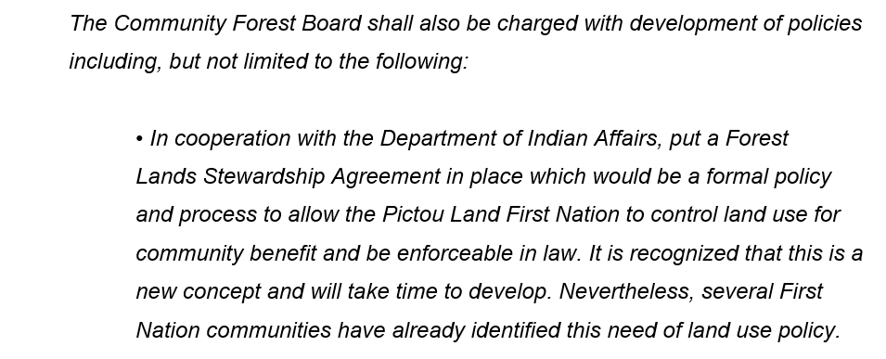
PLFN Pre-Planning Phase Activities
Current Land Use/Forest Management Plan
IR 24
Notes:
Thanks!

Slide 22
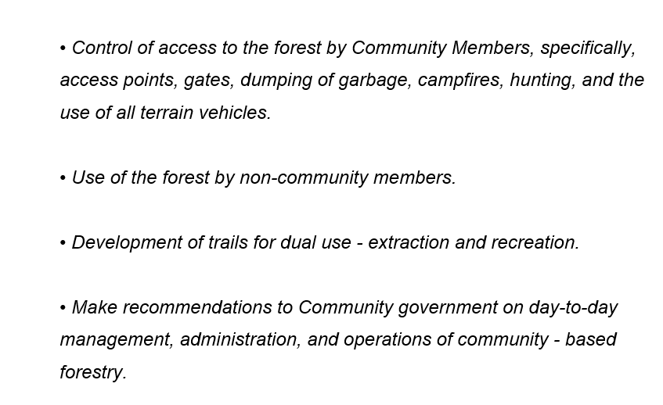
PLFN Pre-Planning Phase Activities
Current Land Use/Forest Management Plan
IR 24
Notes:
Thanks!

Slide 23
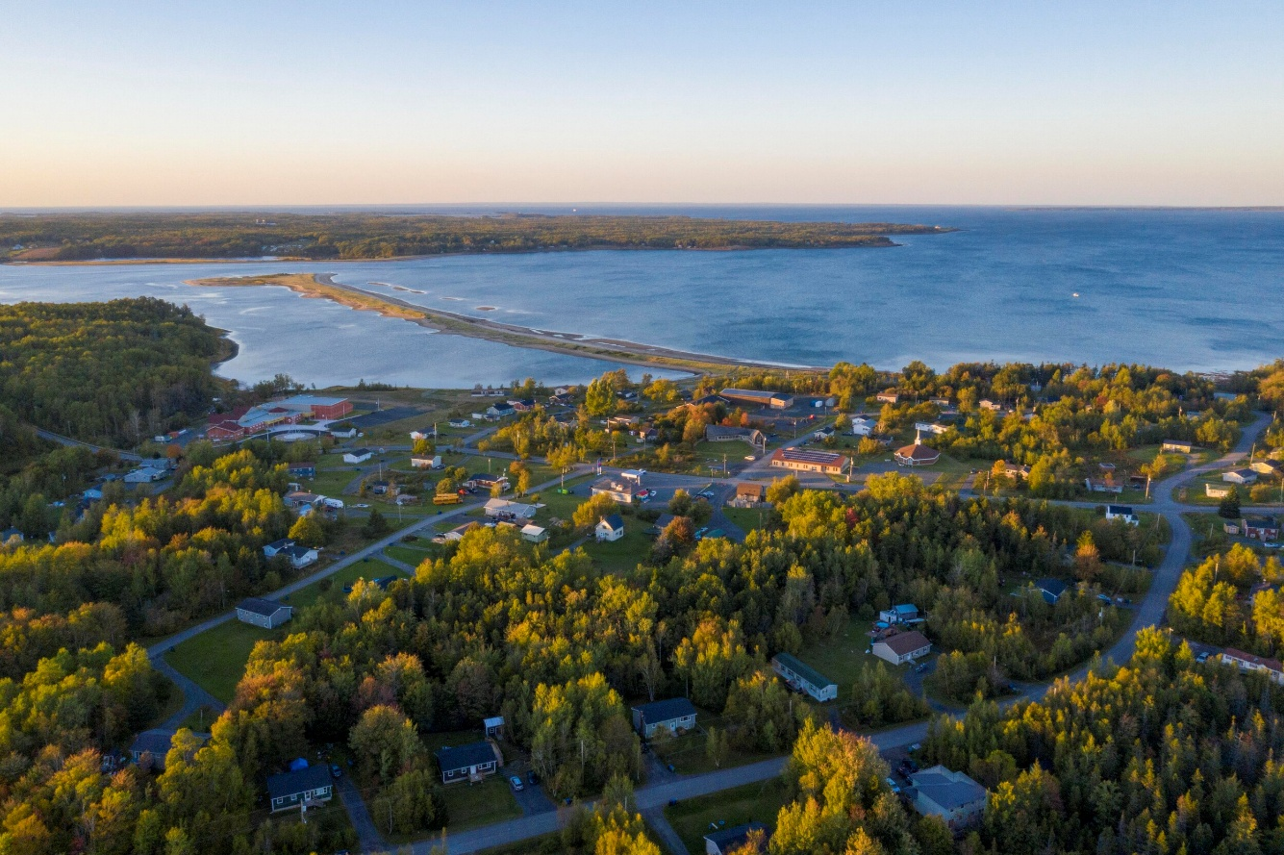
PLFN Pre-Planning Phase Activities
PLFN Land Use Plan
Community Survey
PLFN Land Use Plan Community Survey
Notes:
Thanks!

Slide 24
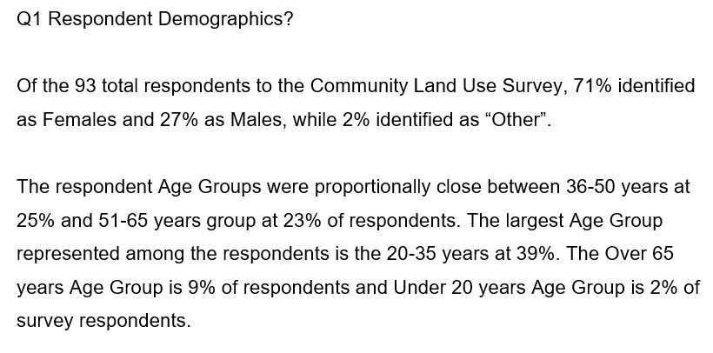
PLFN Pre-Planning Phase Activities
PLFN Land Use Plan
Community Survey
Notes:
Thanks!

Slide 25
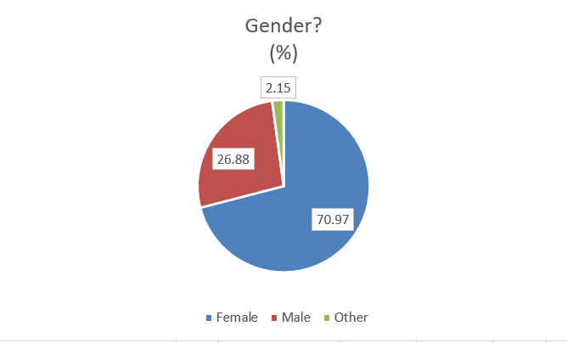
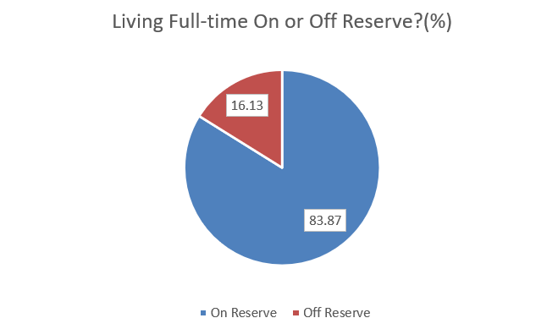
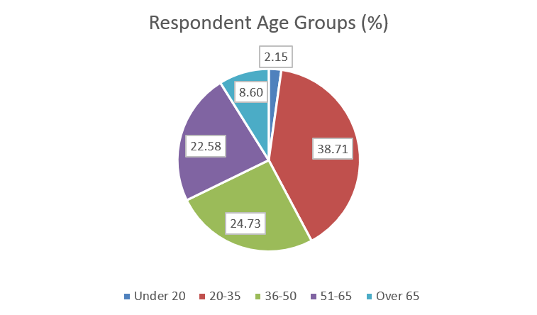
PLFN Pre-Planning Phase Activities
PLFN Community Land Use Survey Results
Respondent Demographics
Q1a
Q1c
Q1b
Under 20

Slide 26
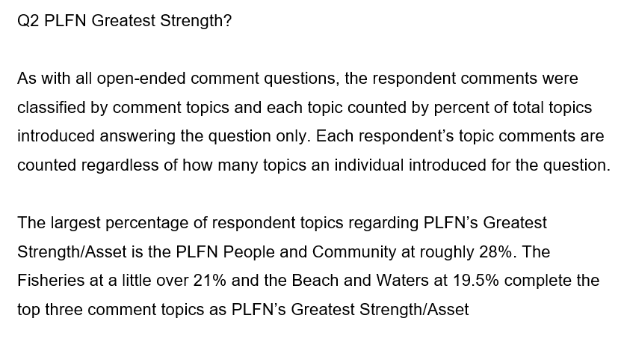
PLFN Pre-Planning Phase Activities
PLFN Land Use Plan
Community Survey
Notes:
Thanks!

Slide 27
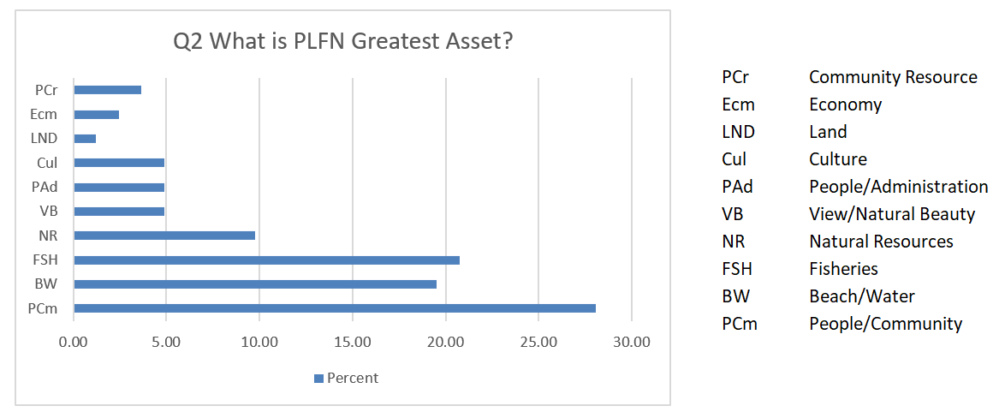
PLFN Pre-Planning Phase Activities
PLFN Land Use Plan
Community Survey
Q2) As a growing community among significant natural assets, what do you consider PLFN's greatest strength?
#1 PCm People/Community
#2 FSH Fisheries
#3 BW Beach/Water

Slide 28
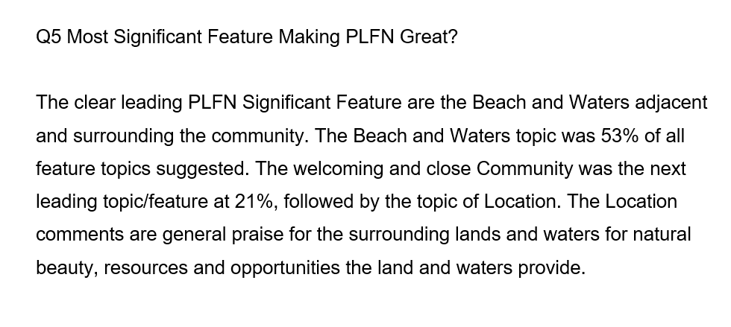
PLFN Pre-Planning Phase Activities
PLFN Land Use Plan
Community Survey
Notes:
Thanks!

Slide 29
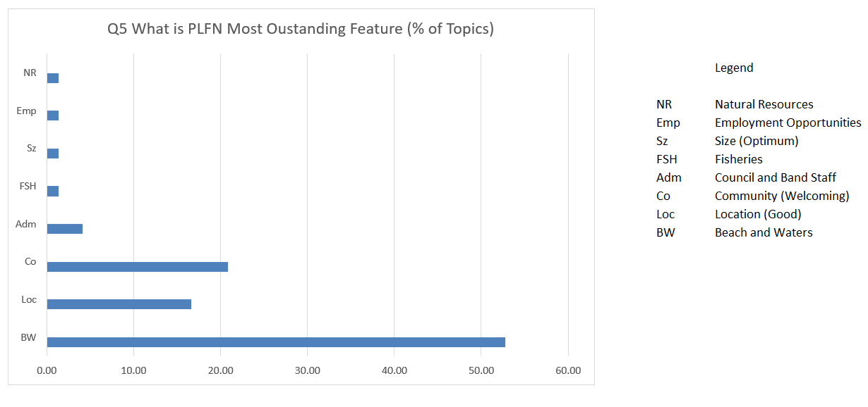
PLFN Pre-Planning Phase Activities
PLFN Land Use Plan
Community Survey
Q5 What do you think is PLFN's most significant feature that makes PLFN great place to live?
#1 BW Beach/Waters
#2 Com Welcoming Community
#3 Loc Location (Good)

Slide 30
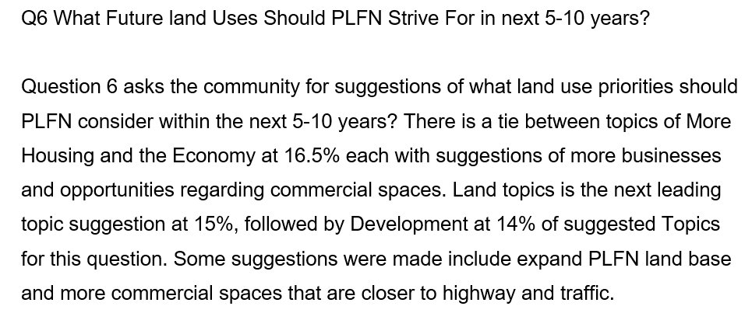
PLFN Pre-Planning Phase Activities
PLFN Land Use Plan
Community Survey
Notes:
Thanks!

Slide 31

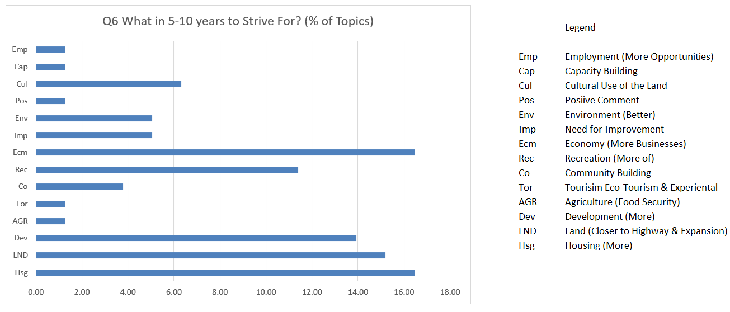
PLFN Pre-Planning Phase Activities
PLFN Land Use Plan
Community Survey
Q6) Within the next 5 to 10 years, what do you think PLFN's future land use aspirations should be?
#1 Hsg Housing (More of)
Ecm Economy/More Businesses
#2 LND Close to Hwy/Expansion
#3 Dev Development (More of)

Slide 32
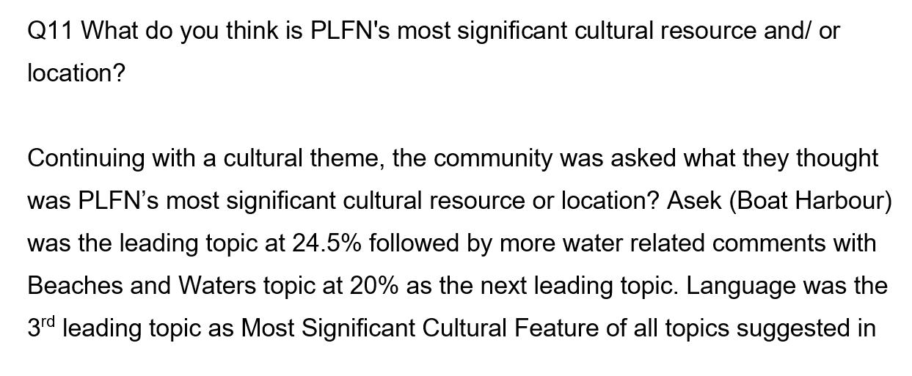
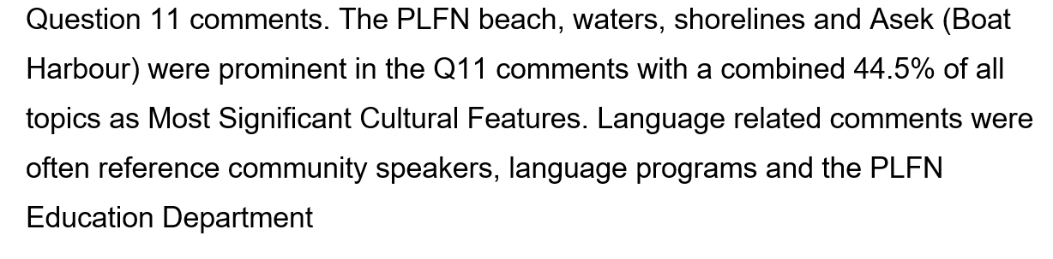
PLFN Pre-Planning Phase Activities
PLFN Land Use Plan
Community Survey
Notes:
Thanks!

Slide 33

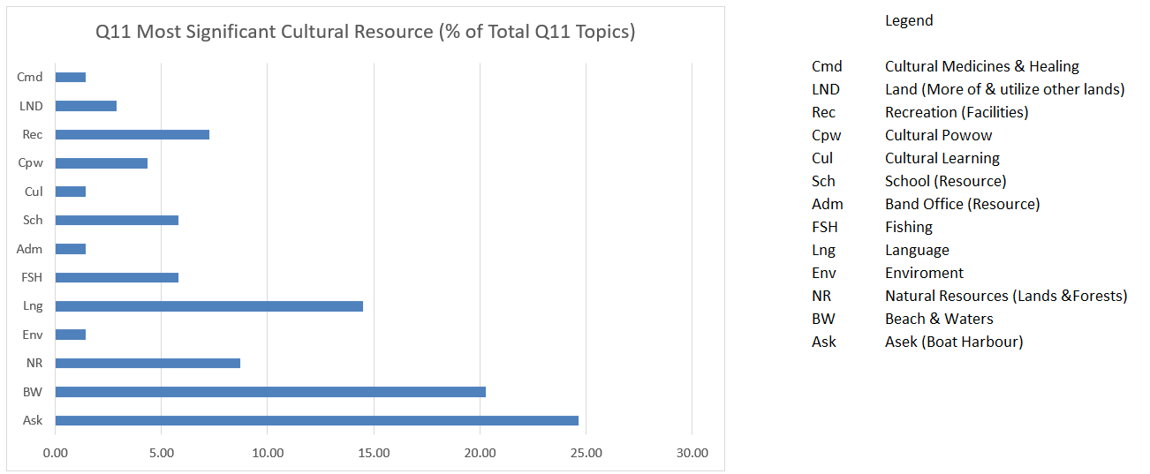
PLFN Pre-Planning Phase Activities
PLFN Land Use Plan
Community Survey
Q11) What do you think is PLFN's most significant cultural resource and/ or location?
#1 Ask Asek (Boat Harbour)
#2 BW Beach and Waters
#3 Lng Language

Slide 34
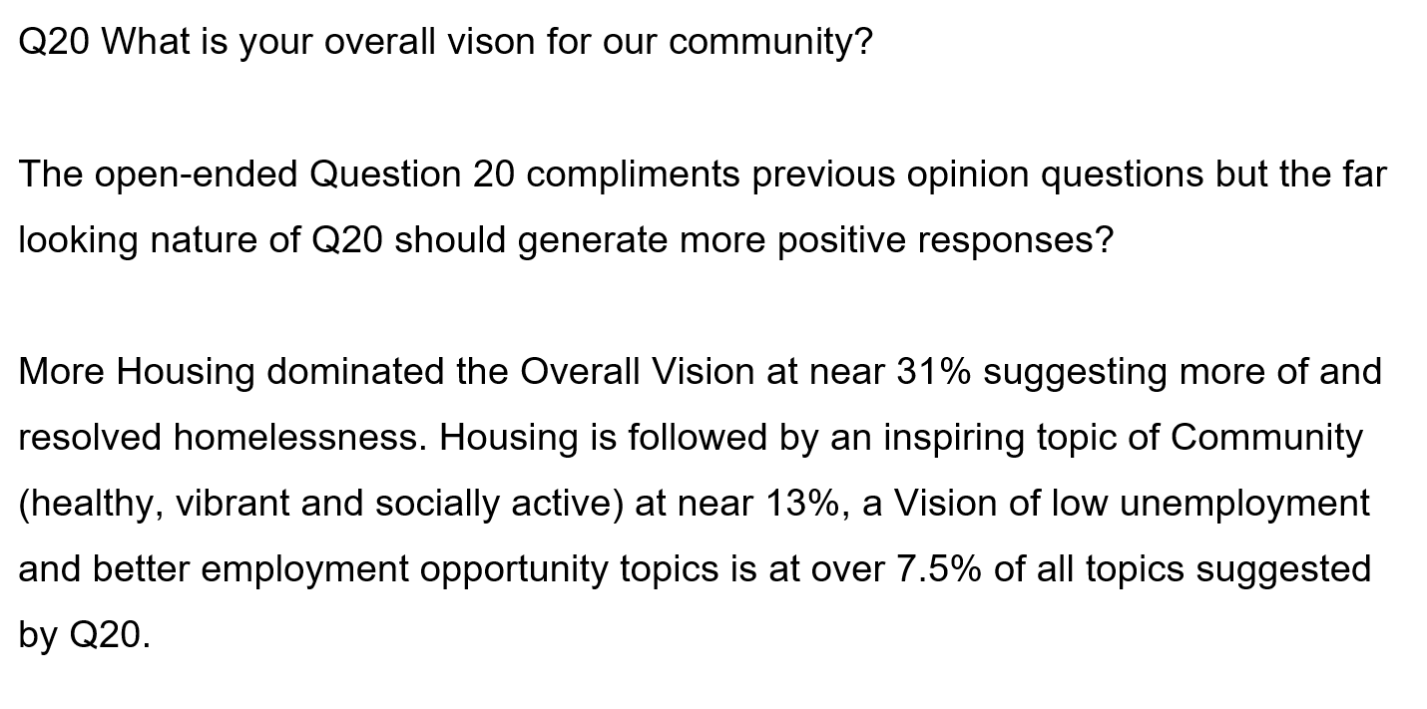
PLFN Land Use Plan
Community Survey
Notes:
Thanks!

Slide 35
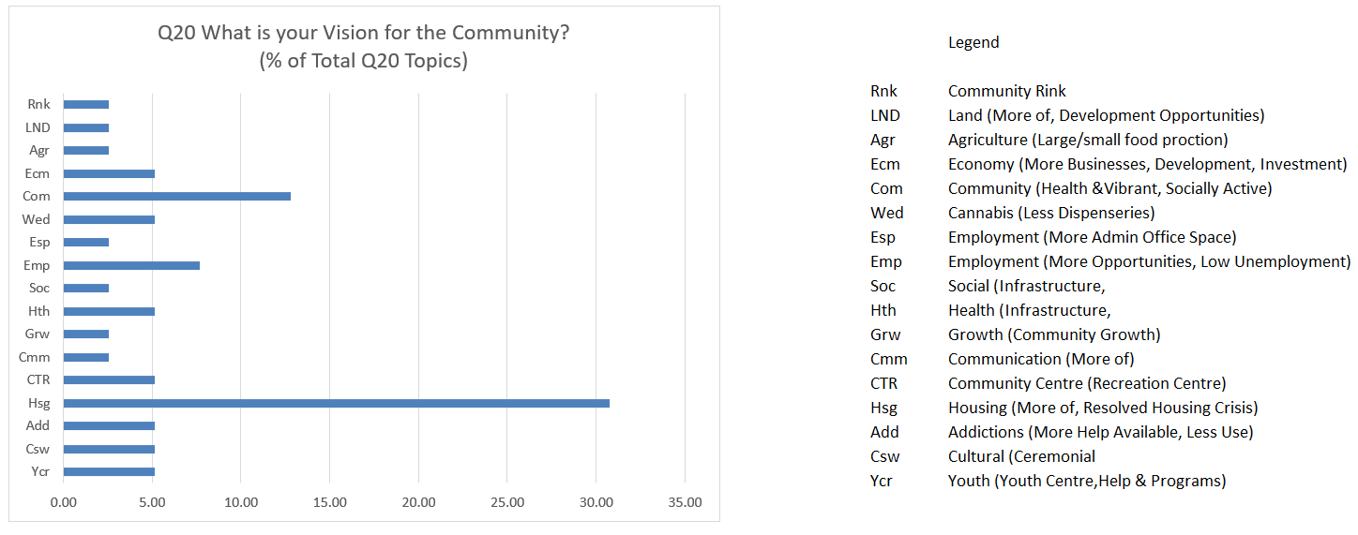
PLFN Pre-Planning Phase Activities
PLFN Land Use Plan
Community Survey
Q20) What is your overall vision for our community, and what specific changes or developments would you like to see implemented?
#1 Hsg Housing (More of)
#2 Com Community Healthy & Vibrant
#3 Emp Employment Opportunities

Slide 36

PLFN Pre-Planning Phase Activities
PLFN Land Use Plan
Community Survey
End Part 1

